Slide 1
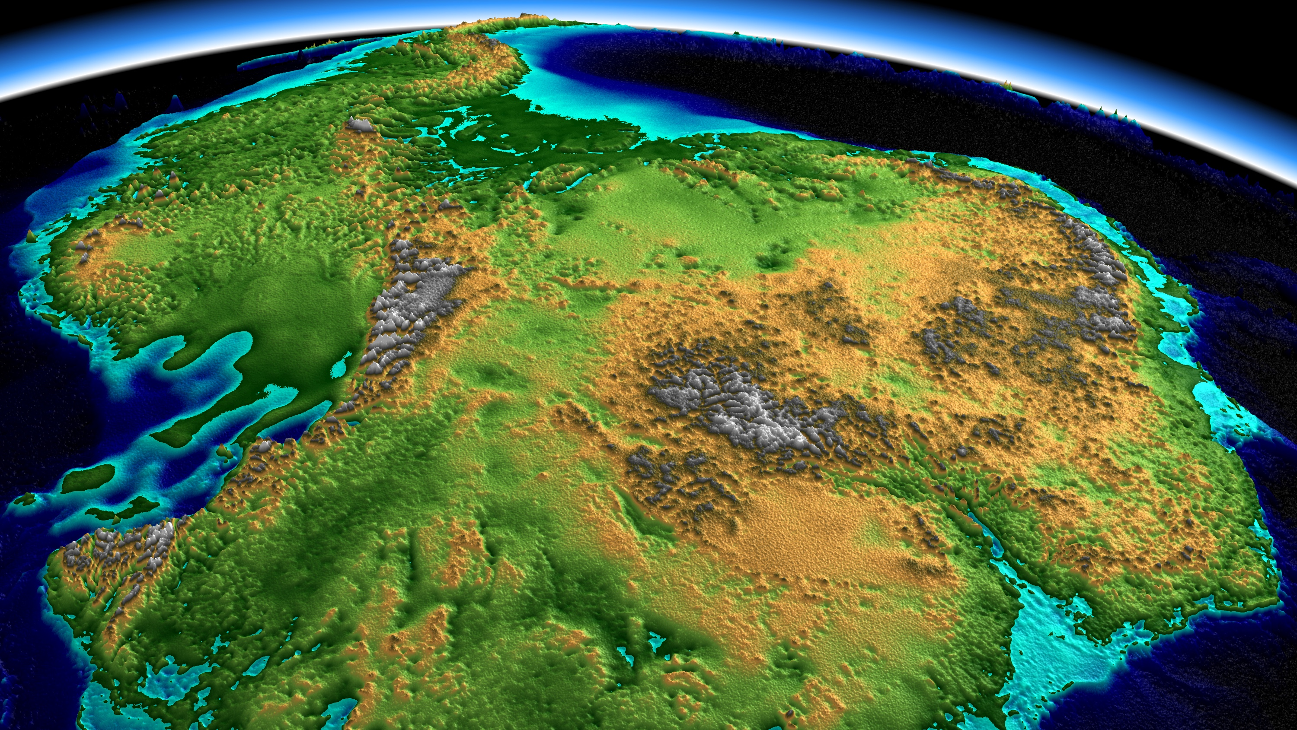

Paleoklimaat simulaties: fascinerend, uitdagend, relevant
Michiel Baatsen – m.l.j.baatsen@uu.nl
WND-conferentie 16 december 2023

Slide 2
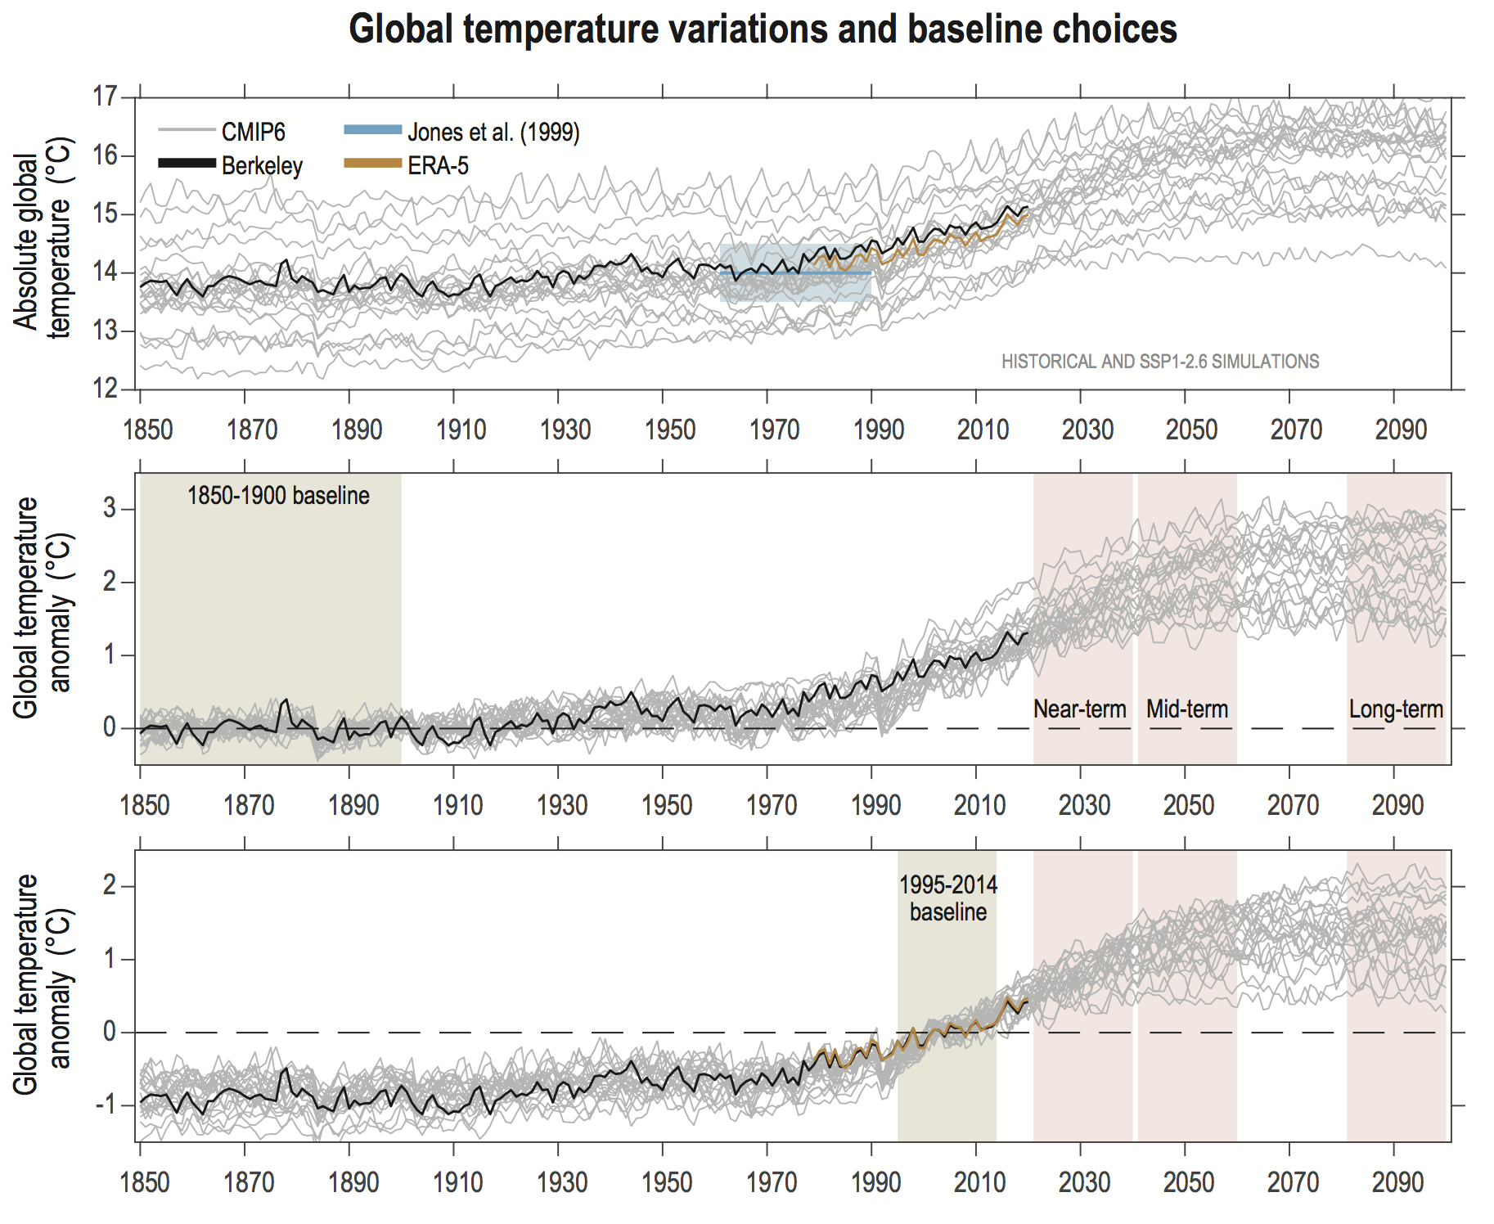
Model biases
Global temperature in CMIP6 models:
Large biases compared to historical record!
These biases are corrected for in the analysis.

Slide 3

Model biases in CMIP6
2023: +1.3$℃$

Slide 4
Biases in climate models
‘All models are wrong…
… but some are useful!’ (George Box, 1976)
A climate model is an imperfect representation of climate;
→ biased in mean, but also variability and correlations.
To check biases, we need observable quantities;
→ e.g. temperature, precipitation, clouds, radiation.
Alternative to observations: model reanalysis.
Models are tuned to minimise biases wherever possible.

Slide 5
Weather versus climate models
Many different (operational) weather models are used;
Global: GFS (NCEP), IFS (ECMWF), UKMO, JMA, GEM, ICON, Arpège, …
Resolution: 15-50km, simulation length: 5-15 days.
Regional: WRF, RACMO, HiRLAM, ICON, …
Resolution: 5-15km, simulation length: 2-5 days.
Local: WRF, HARMONIE, AROME, COSMO/ICON-D2, …
Resolution: 1-4km, simulation length: 1-3 days.
Only atmosphere, sometimes also land and/or sea surface.
For these models, initial and boundary conditions are very important!

Slide 6
Weather versus climate models
A climate model is principally the same as a weather model; but run much longer.
IFS → EC-Earth, GFS → CESM, UKMO → HadCM, GFDL, IPSL, …
Rather than days to weeks, we want to simulate decades or even centuries.
This has several consequences:
The conservation of energy/momentum becomes very important;
Climate models can (almost) only be global;
Many more active components are needed compared to weather models:
Atmosphere, Ocean, Land, Ice, Vegetation, Chemistry.
Simulations need a spin-up or equilibration.
Model complexity and simulation length limit the resolution (50-200km).
We consider climate, rather than weather.

Slide 7
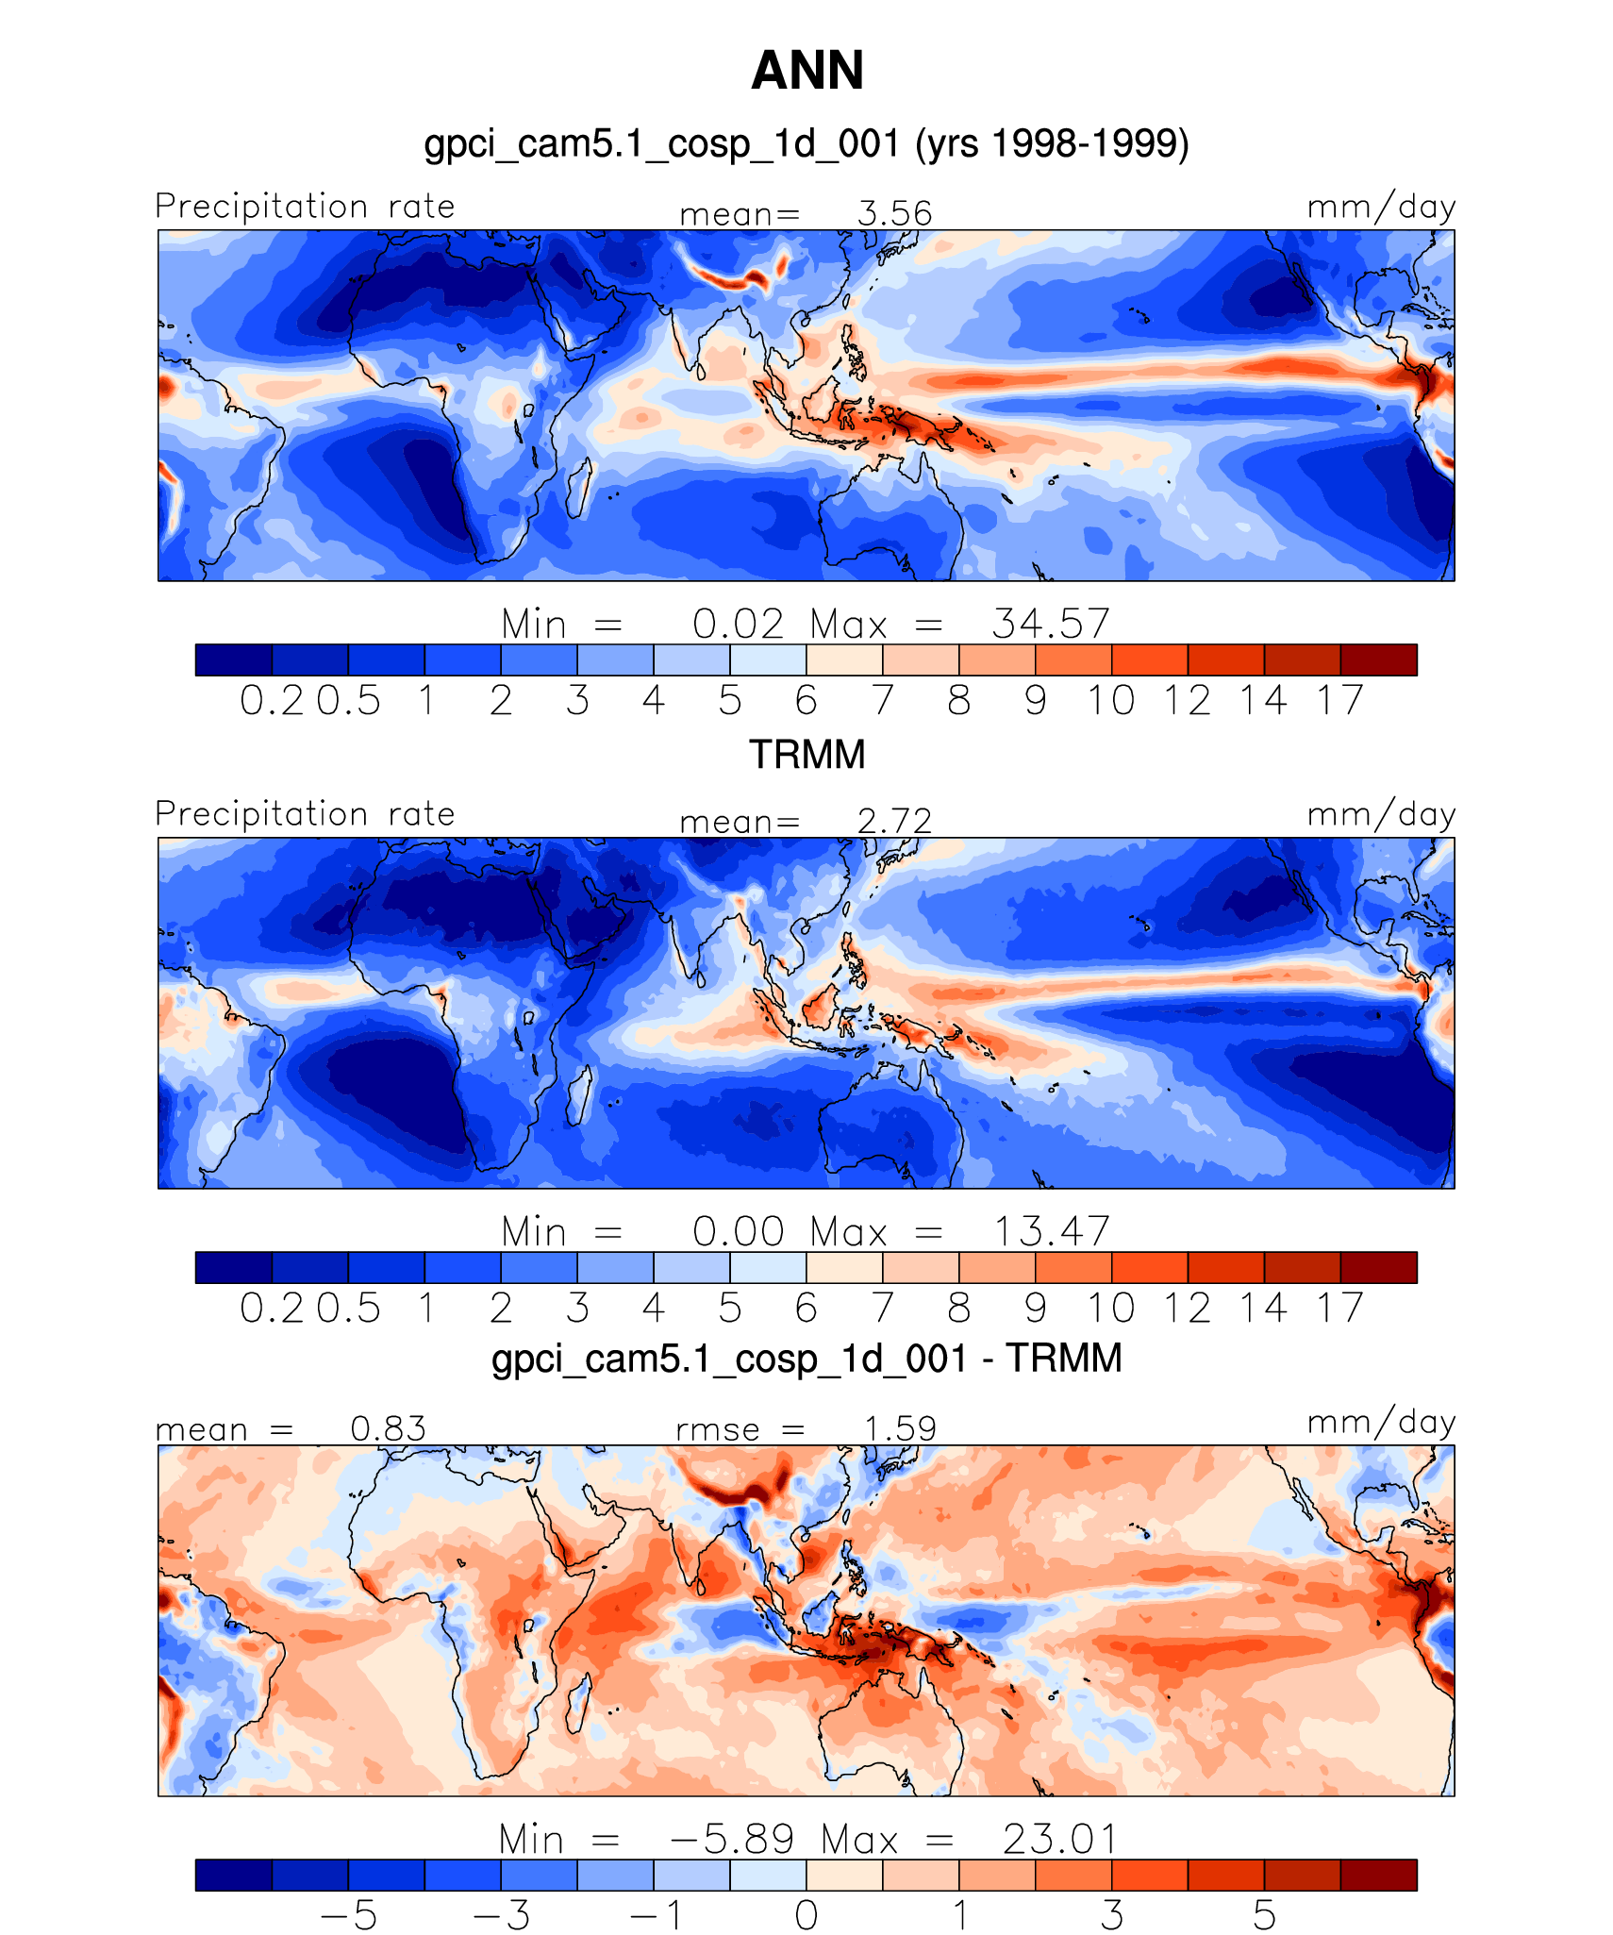
Model bias: CAM5 (CESM) tropical precipitation
Simulated:
Difference:
Observed:

Slide 8
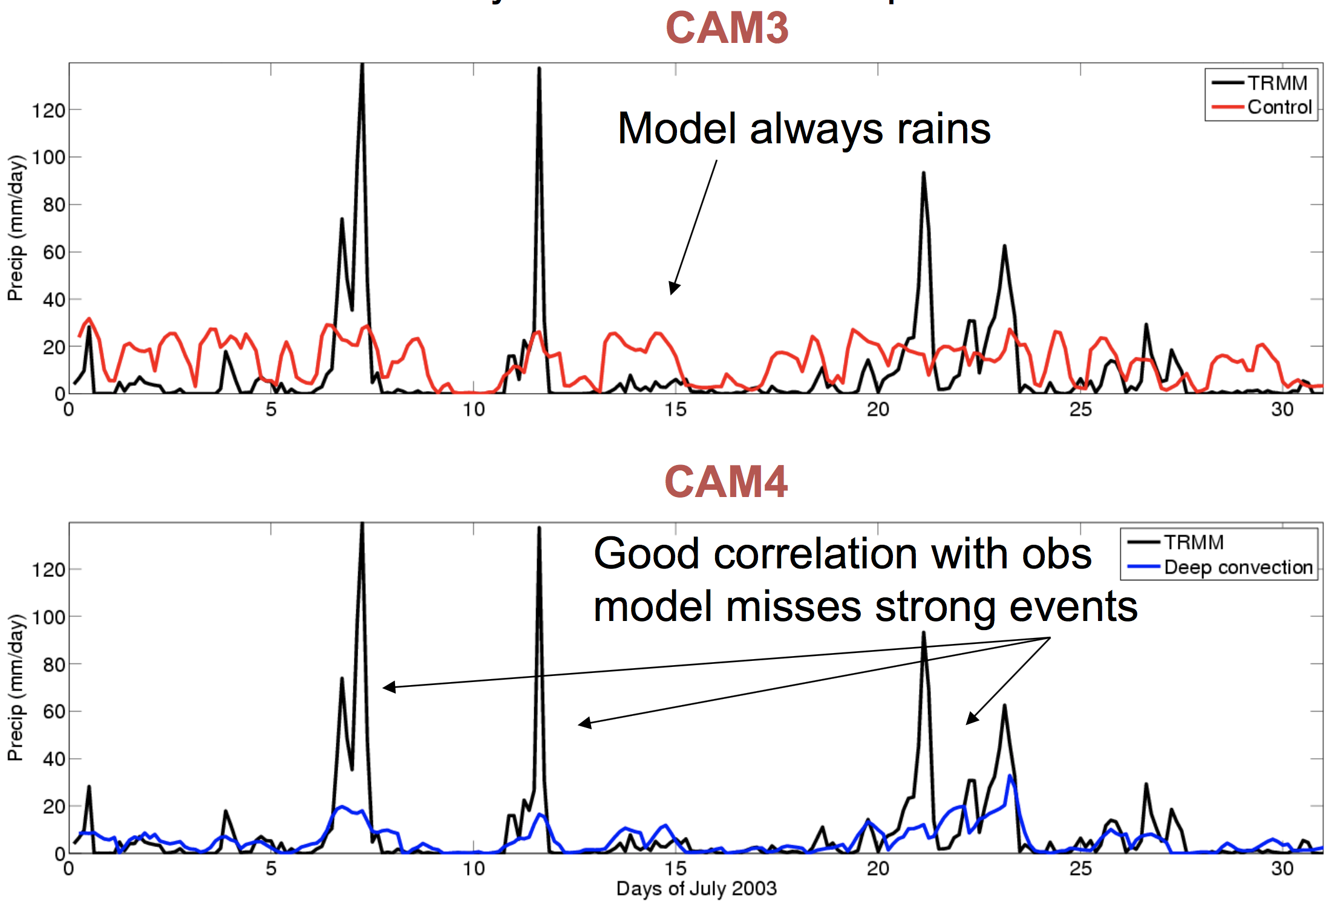
Example: hourly rainfall over tropical E Pacific

Slide 9
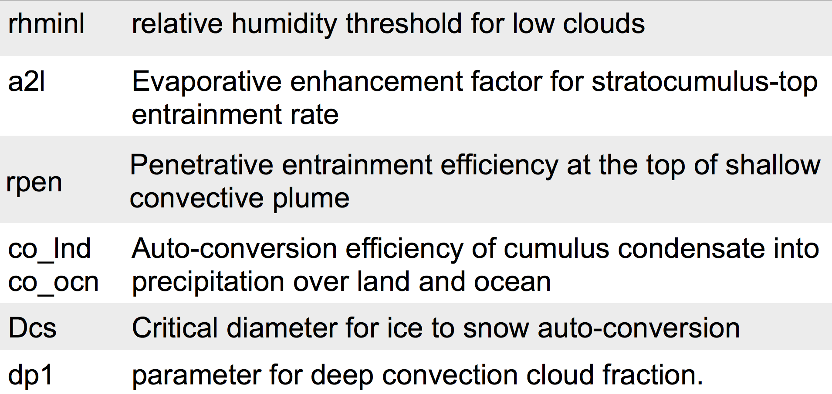
Model ‘tuning’
Tuning: adjusting parameters to improve agreement with observations
Which parameters are used for tuning?
Those weakly constrained by the observations.
(e.g. convection, clouds, aerosols, radiation, fluxes)
Examples:
(>20 in CAM5)

Slide 10
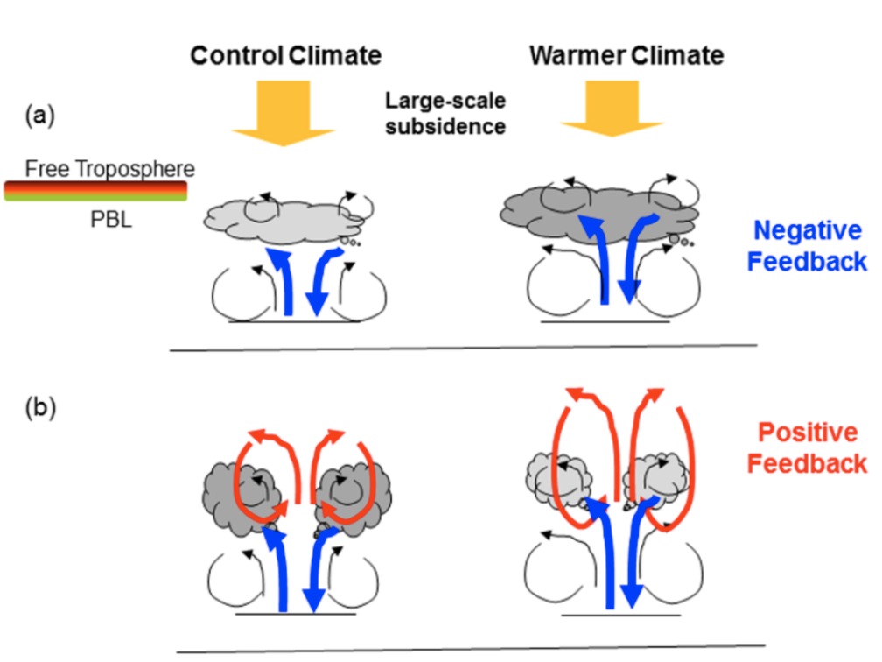
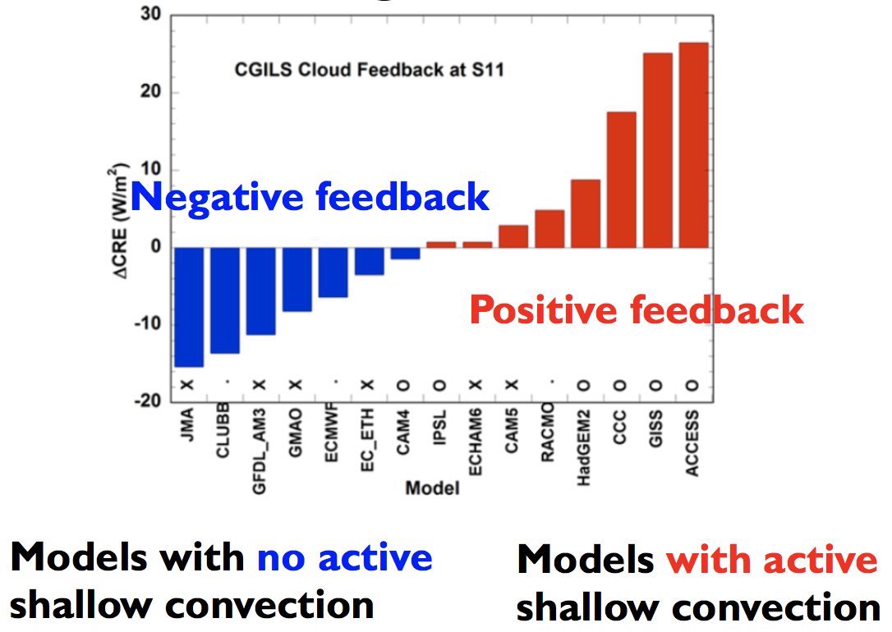
Example: parameterisation of shallow convection

Slide 11
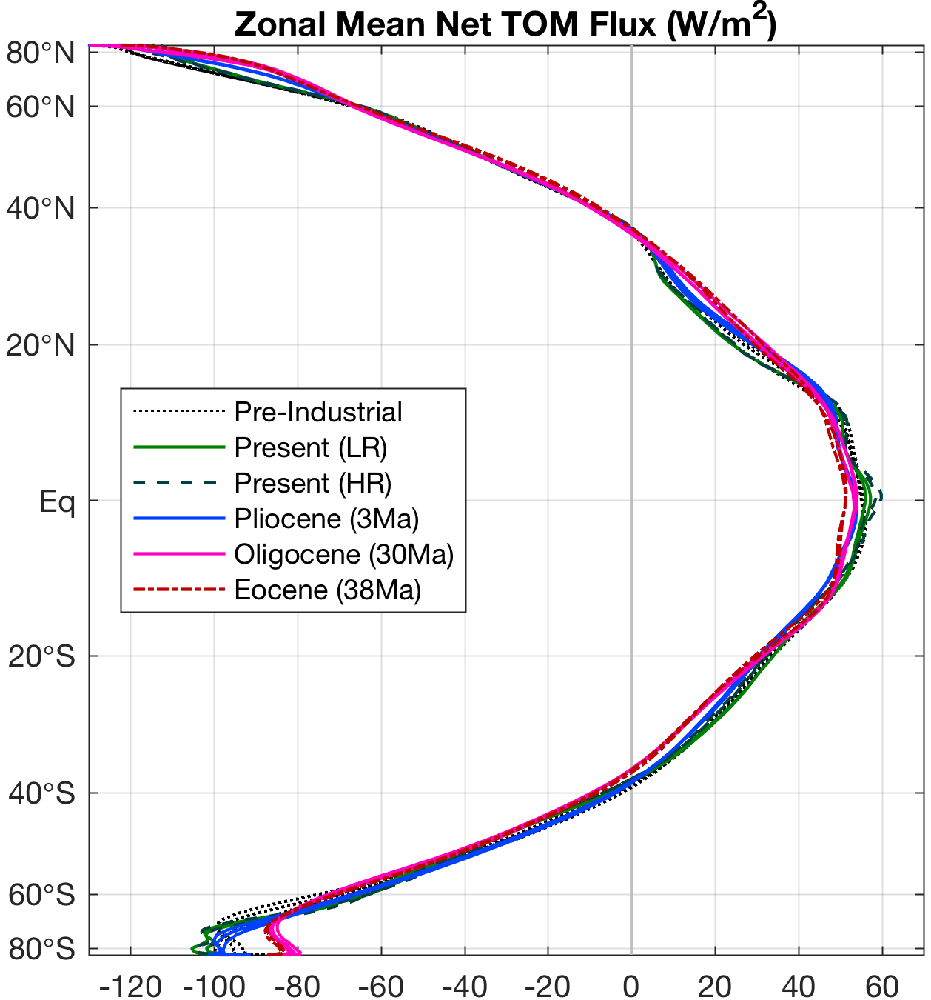
Model ‘tuning’
Most commonly used variables:
Top of atmosphere radiative balance;
Shortwave/longwave cloud forcing;
Total precipitable water;
Precipitation.
These variables are compared against the
available observational and reanalysis datasets,
using coupled/uncoupled simulations.

Slide 12
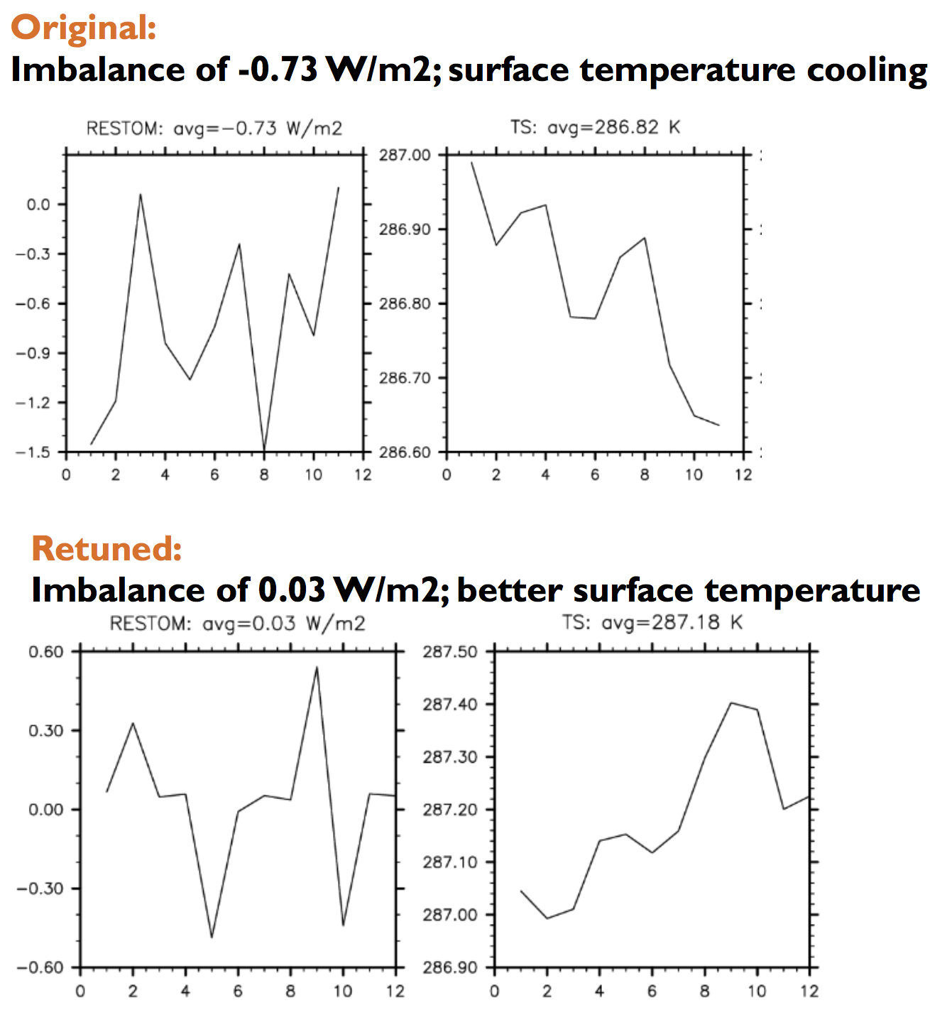
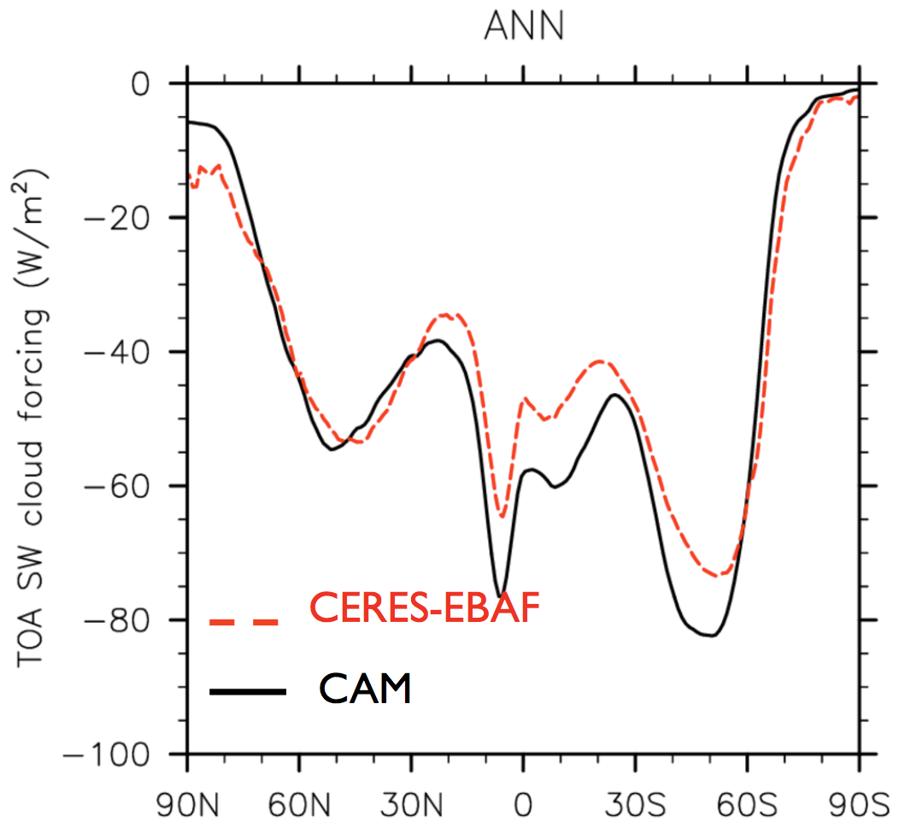
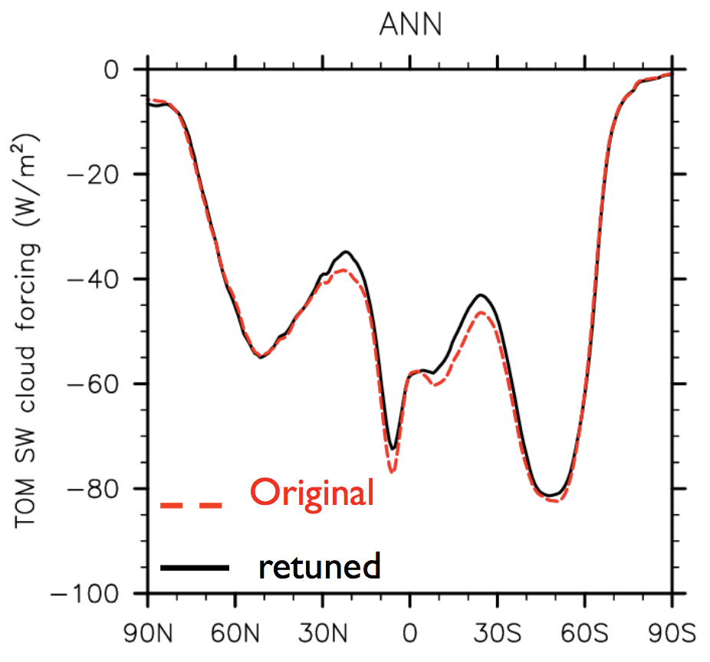
Model tuning example: CAM6
Cool model bias,
radiative imbalance.
SWCF too strong, parameters adjusted
to reduce low clouds.
Adjusted model version has much better balance and temperatures.
TOA radiative balance very important (drift).

Slide 13
Summary model bias and tuning
Models are never perfect!
Model biases detected with observations, also not perfect!
Tuning models: adjust parameter settings;
Consider variables poorly constrained by observations.
All models need tuning, often delicate process.
Open questions:
We tuned our climate model to our best capabilities;
How will it perform under different conditions?
The underlying physics are sound, but what about the parameterisations?

Slide 14
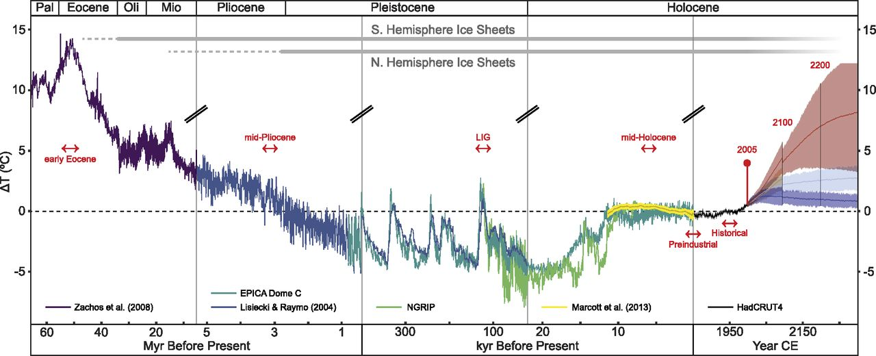
Paleoclimate modelling: learning from the (deep) past
Eocene:
‘hothouse’
Pliocene:
400ppm analogue
Last Inter-Glacial:
present analogue
Holocene:
‘Stable’ reference
Burke et al. (2018)

Slide 15
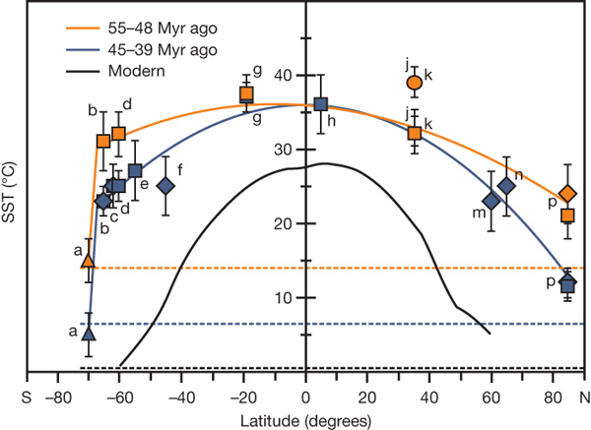
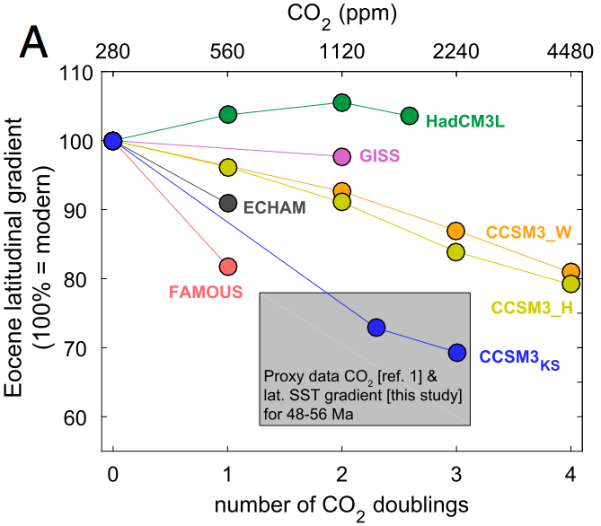
Why do we simulate paleoclimate?
Understand palaeoclimate;
very limited data.
Find out fundamental
properties of warm climates.
Find and study analogues
for present/future climate.
Test climate models
beyond their comfort zone.
Challenge:
‘Equable’ climates
Bijl et al. (2009)
Evans et al. (2018)

Slide 16
Putting these time scales into perspective
Westerhold et al. (2020)

Slide 17
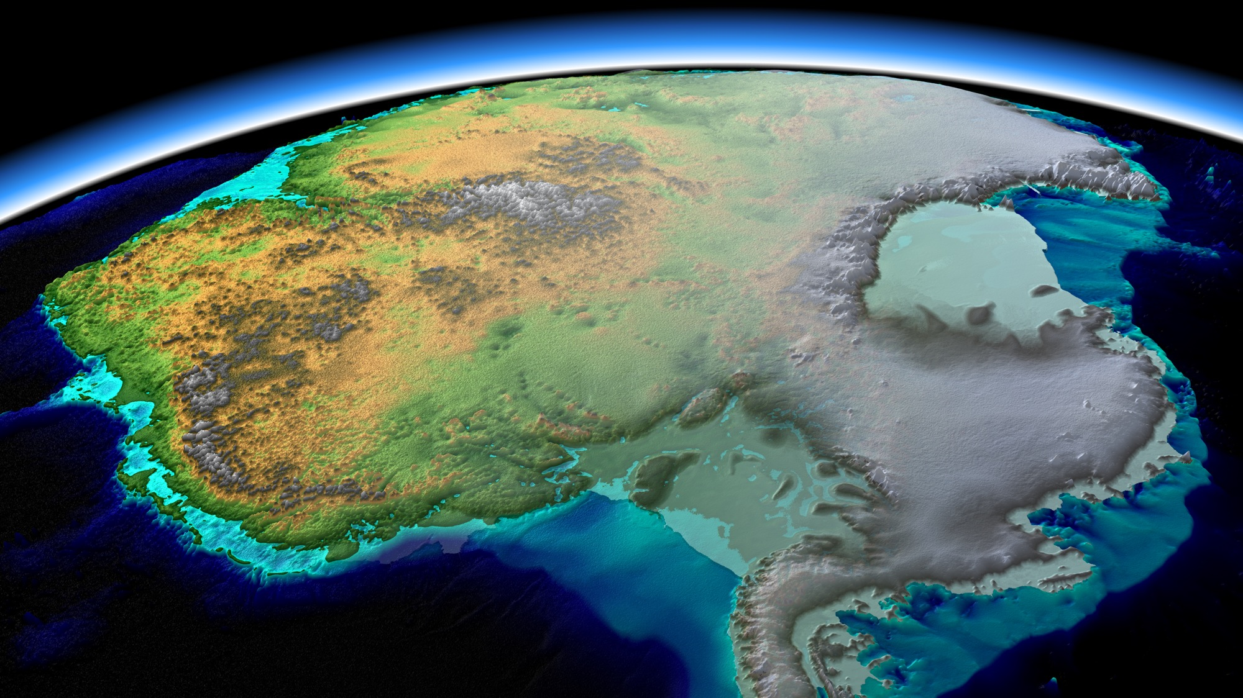
The EOT: a prime example of a climate tipping point?
Icehouse
EOT
Ice Volume
Greenhouse
Radiative Forcing

Slide 18
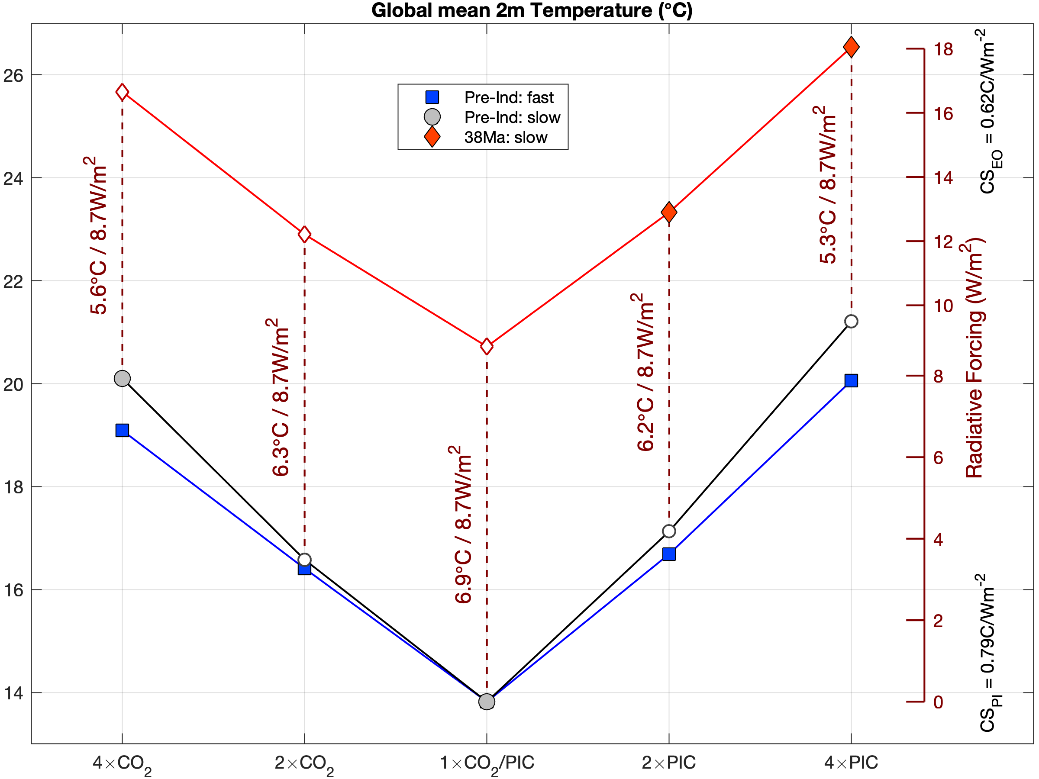
Climate state hysteresis: greenhouse vs icehouse
Boundary conditions
in the model are fixed;
Eocene climate is much warmer than today.
Different states;
ice, vegetation, clouds, …
Equilibrium state versus current rapid change;
Possible analogue
for a distant future?
Greenhouse
Icehouse

Slide 19
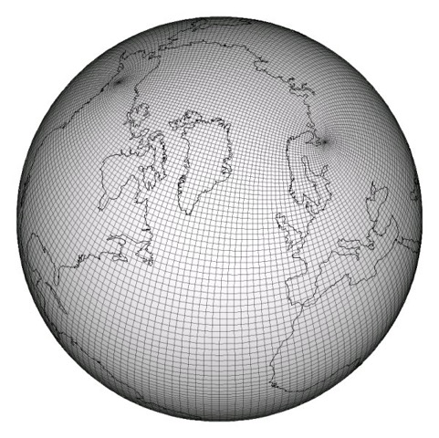
At IMAU: CESM 1.0.5 for paleoclimate
The CESM:
Global, fully-coupled climate model;
Atmosphere – Ocean – Ice – Land – Vegetation.
2010 state-of-the-art (IPCC AR5); limited complexity.
Deep-time model set-up:
Horizontal resolution: ∼2° (atmosphere) / ∼1° (ocean).
Altered boundary conditions:
  Atmospheric composition (aerosols, greenhouse gases);
  Geography, ice and vegetation cover (some are long-term feedbacks);
  Astronomical configuration (orbital parameters).
Idealised initialisation, long spin-up (1000s years)

Slide 20
Paleoclimate simulations at IMAU:
Pre-industrial/present:
Pre-industrial reference: 3000+3000 years;
CO₂ doubling / quadrupling: 1000+1500 / 2000 years.
Pliocene:
400ppm CO₂ ‘reference’: 2000 years;
280 / 560ppm CO₂ ‘sensitivity’: 1000 years each;
Miocene: simulations are underway.
Eocene:
30Ma 1× / 2× PIC: 3500 years each + 1200 years (FW);
38Ma 2× / 4× PIC: 3600 / 4600 years;
38Ma low insolation orbit: 4 times 500 years.
Over 30.000 model years

Slide 21
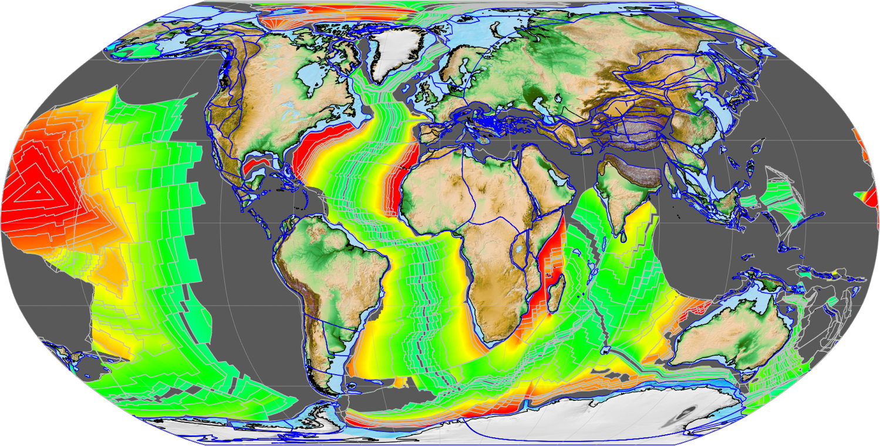
Paleoclimate modelling: geography reconstruction
Plate-tectonic
reconstruction:
e.g. 38Ma

Slide 22
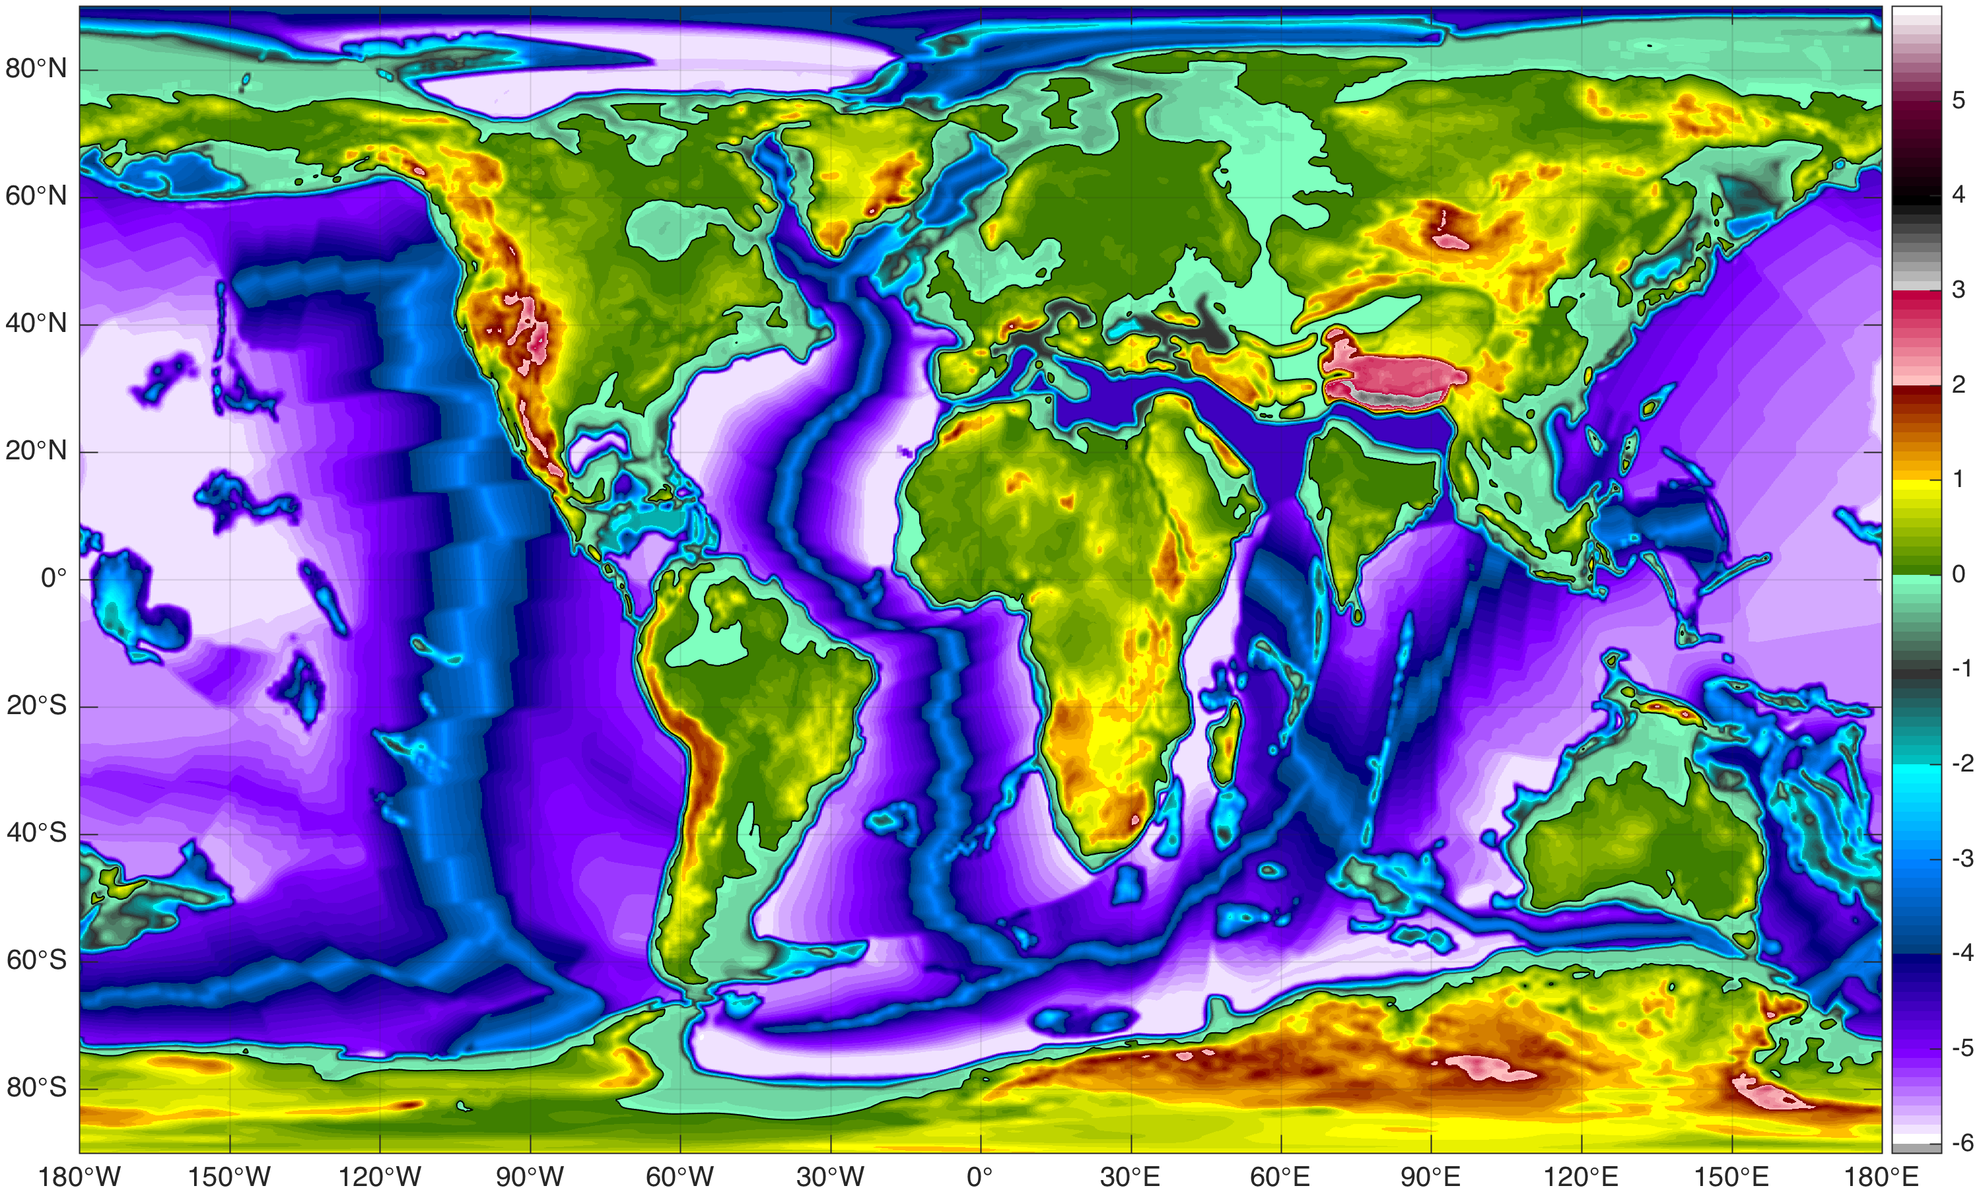
Paleoclimate modelling: geography reconstruction
Final gridded paleogeography reconstruction
for 38Ma:
Areas of interest:
Eurasia
India
Antarctica
Neotethys
Arctic
Gateways

Slide 23
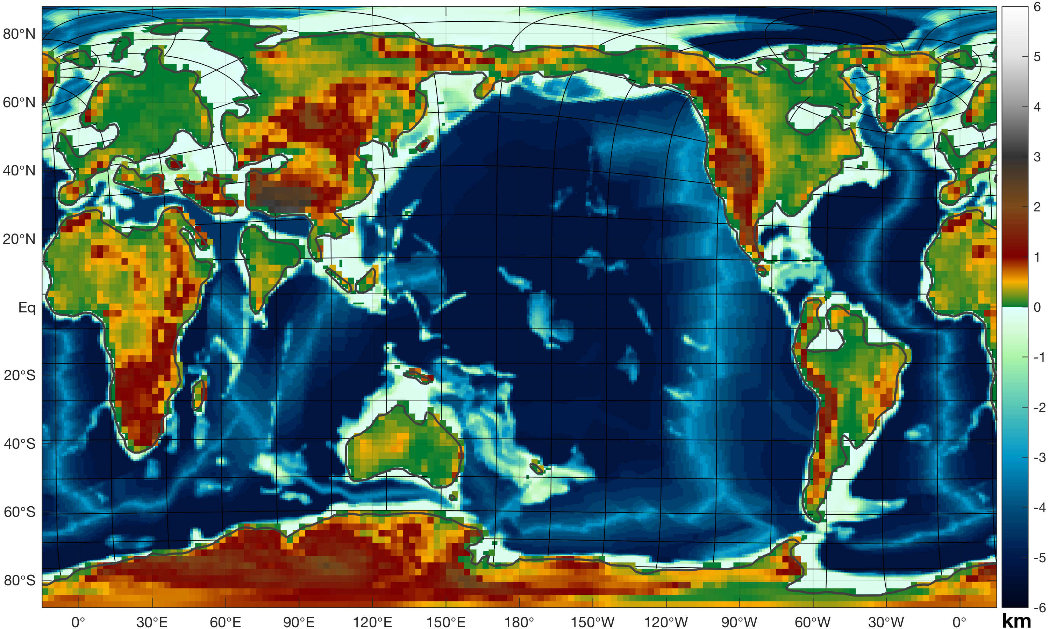
Paleoclimate modelling: geography reconstruction
Model version
of gridded 38Ma paleogeography:

Slide 24
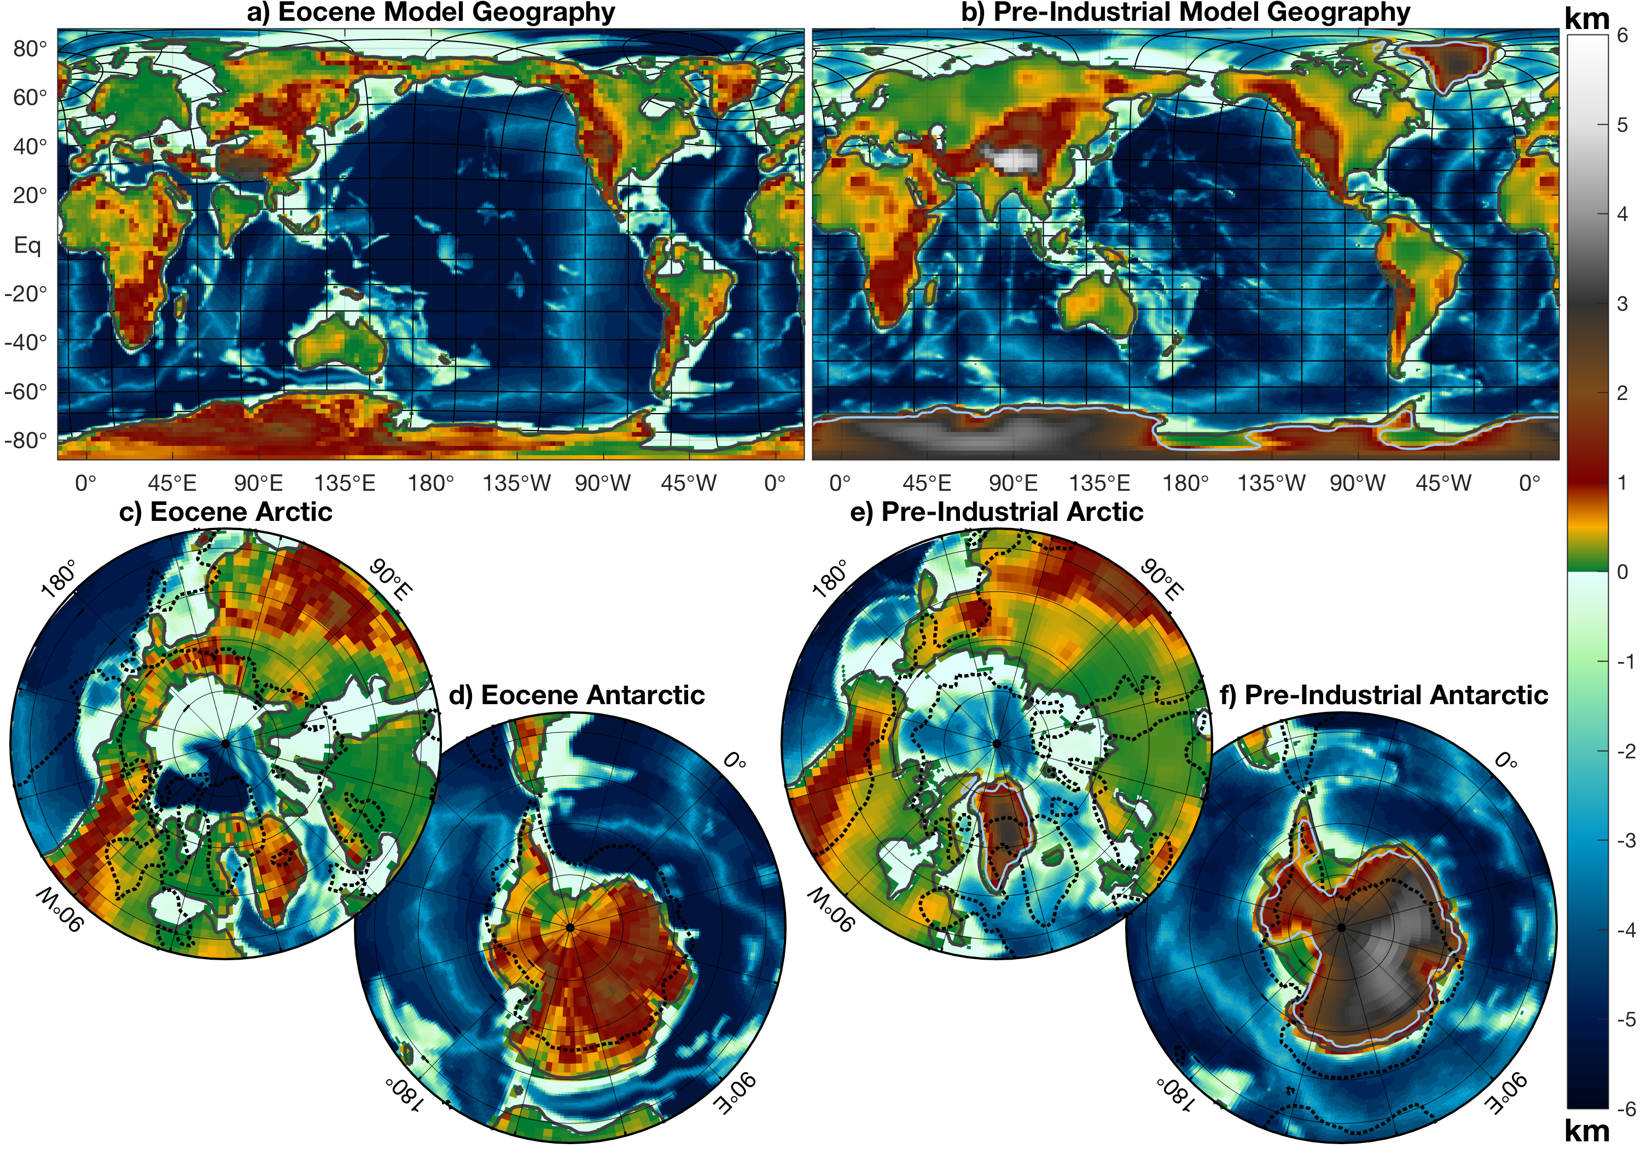
38Ma Eocene
Present

Slide 25
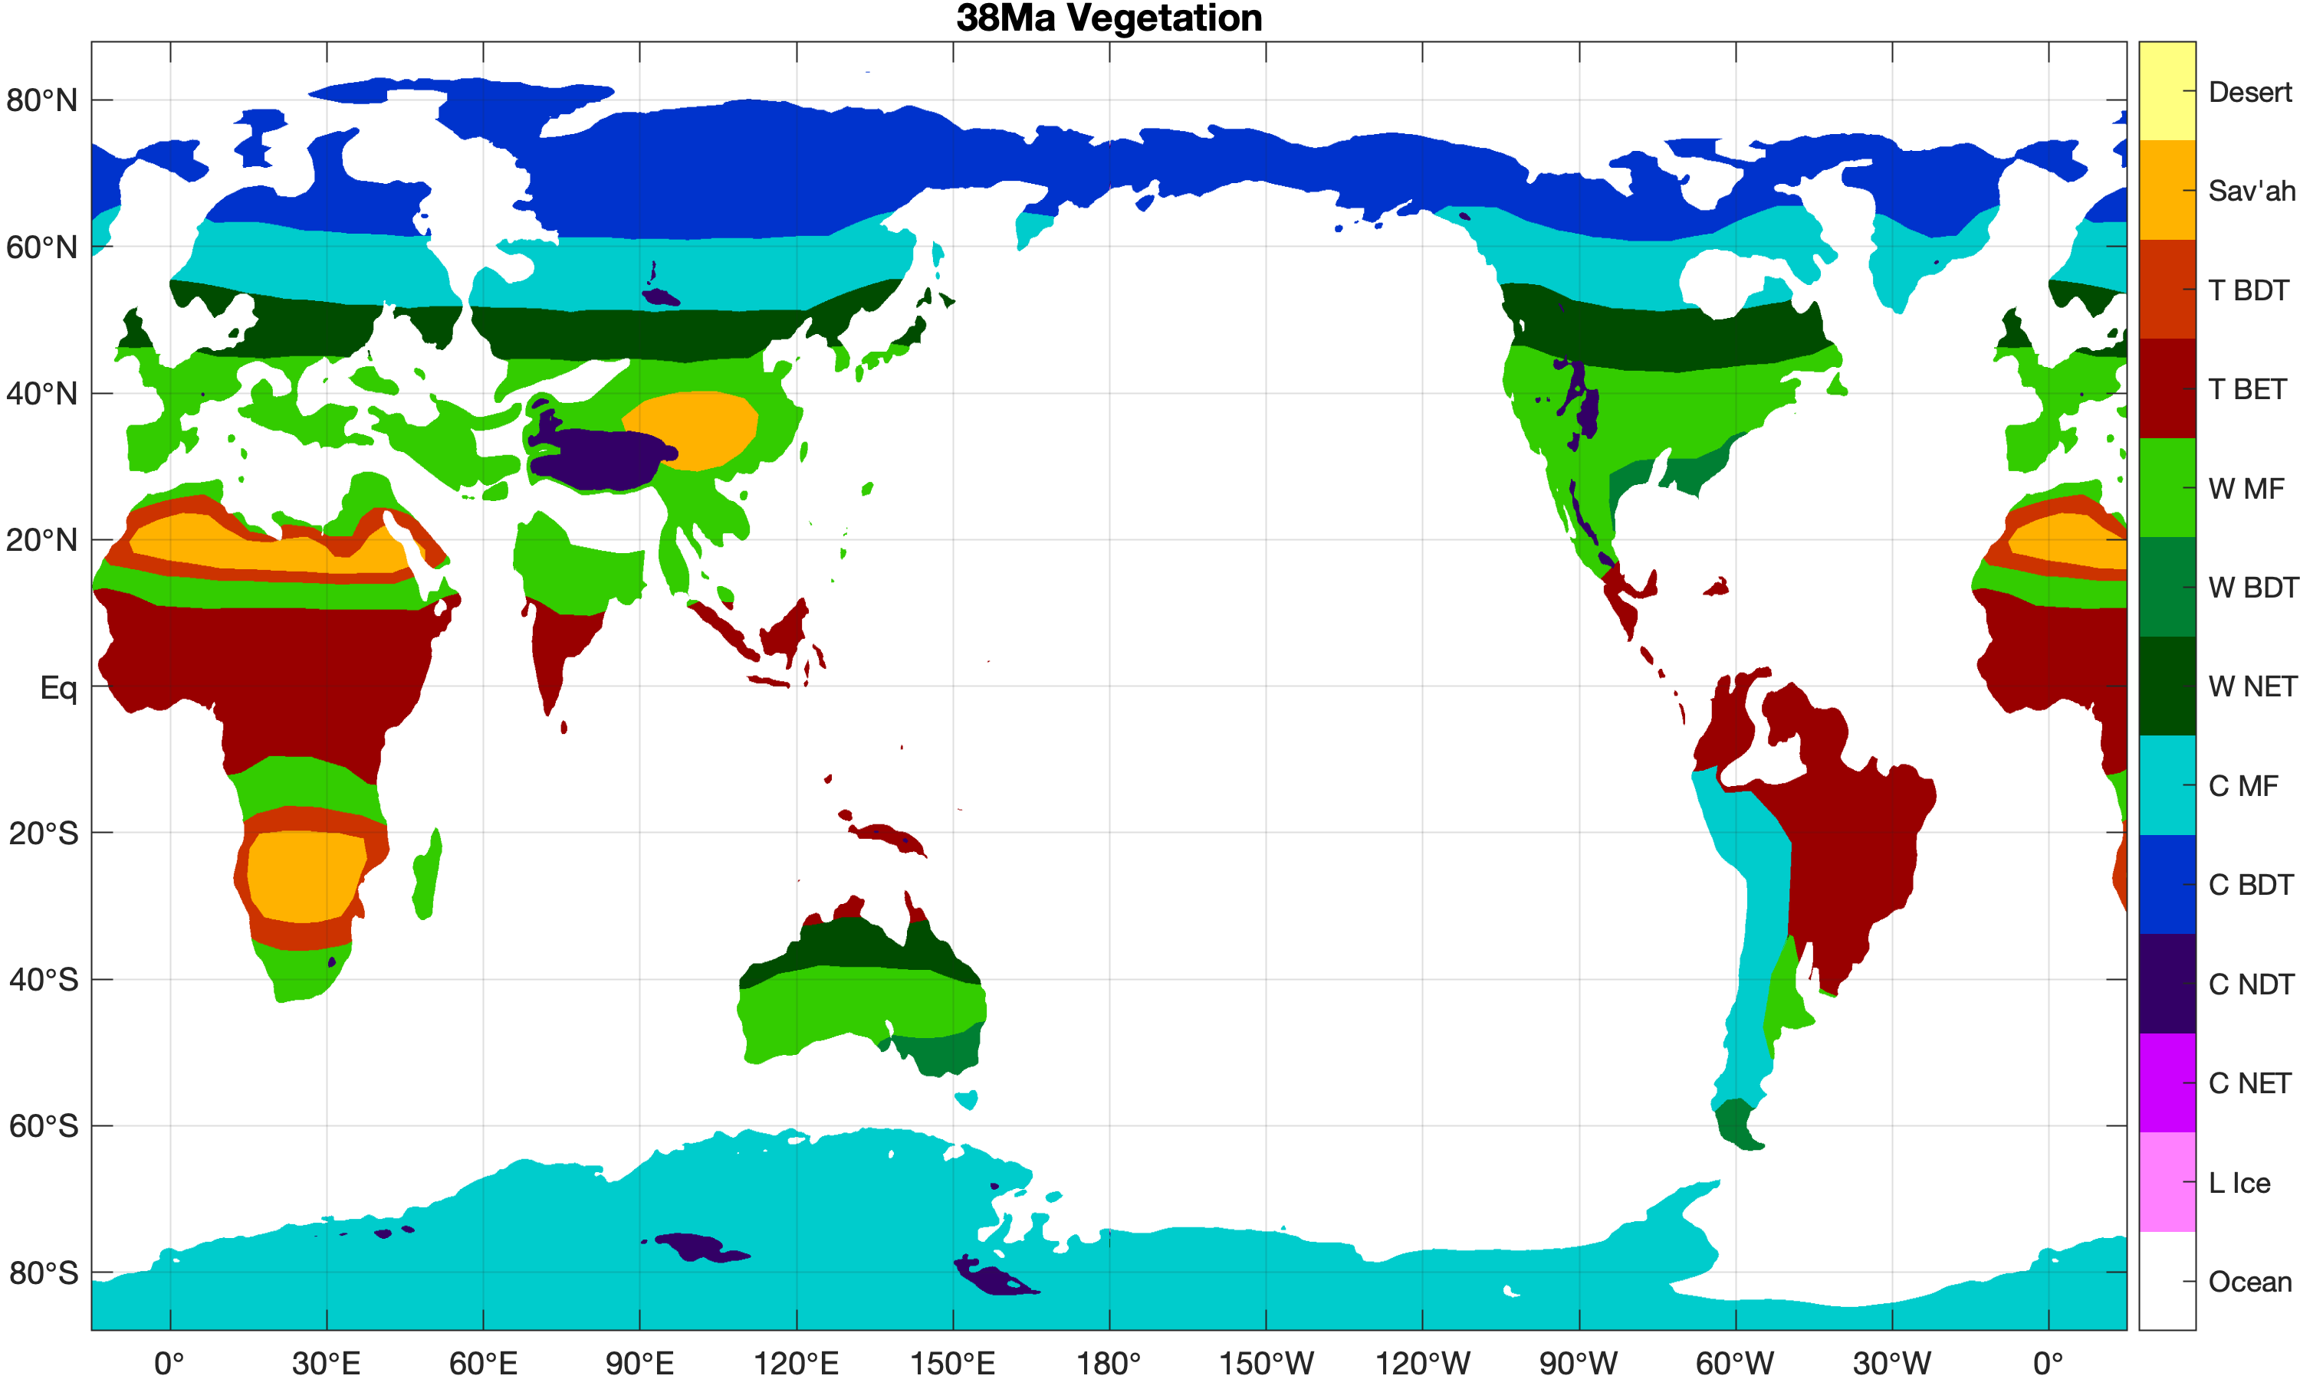
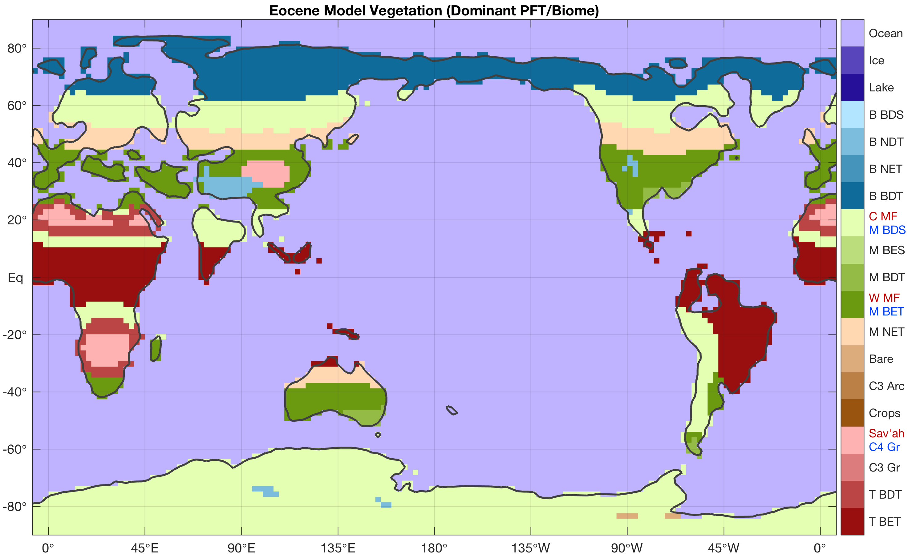
Vegetation: can’t see the forest for the trees
In the model: ‘Plant Functional Type’ (PFT)
Reconstructed biomes translated into distribution of these PFTs.
This did not always go according to plan…

Slide 26
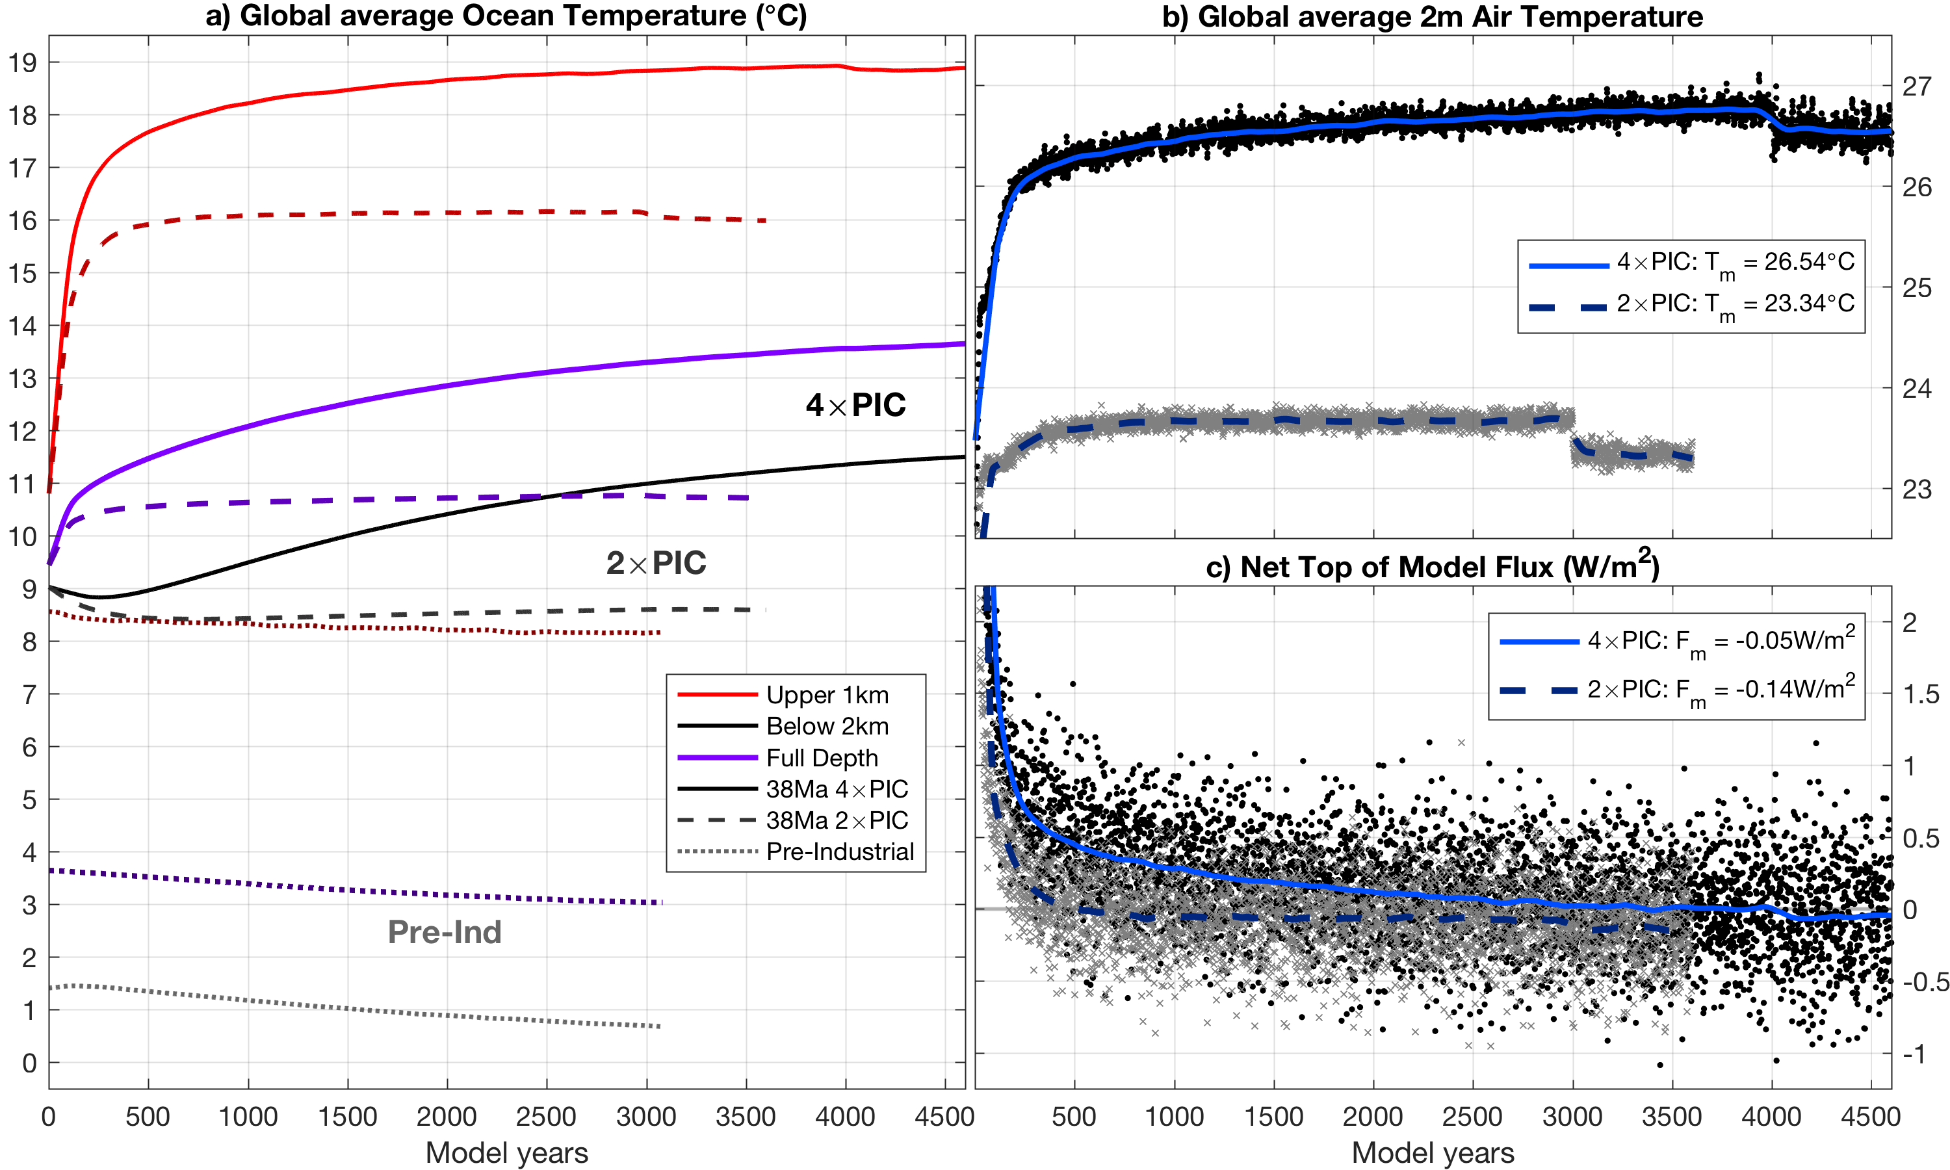
Model initialisation and spin-up: example
Highly idealised initial temperature and salt distributions are used.
A very long spin-up is needed to equilibrate the simulated climate!

Slide 27
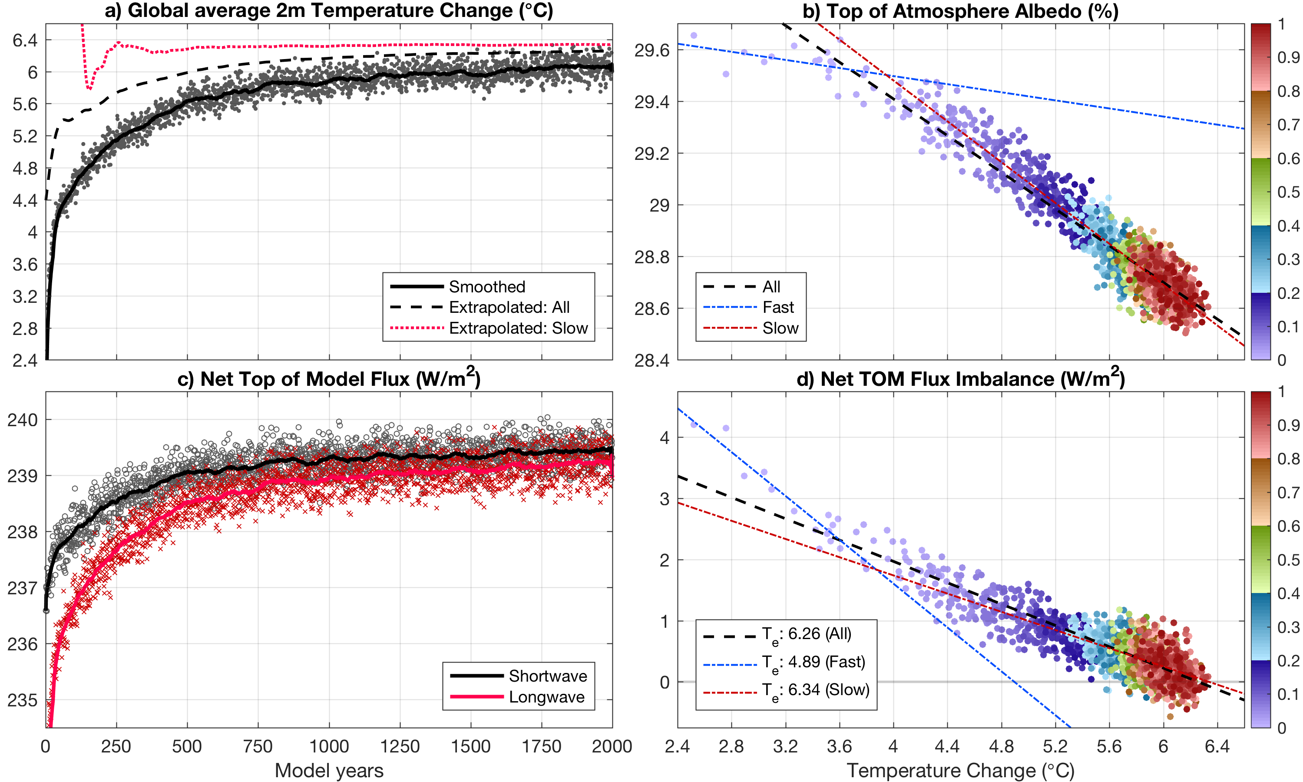
Climate sensitivity: CO₂ doubling/quadrupling

Slide 28
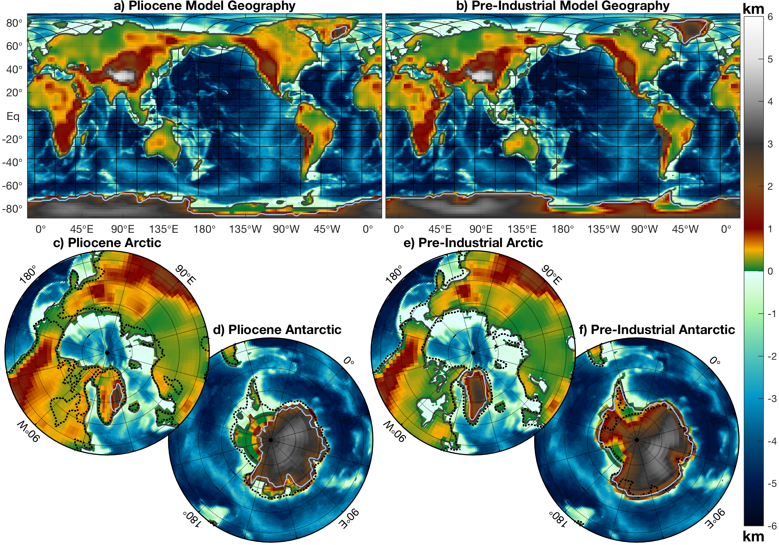
The Pliocene: a 400ppm (~2015) world
Often considered as the best candidate for
a ‘future analogue’
Higher CO₂, but also other adjustments;
Geography
Ice sheets
Vegetation
Aerosols

Slide 29
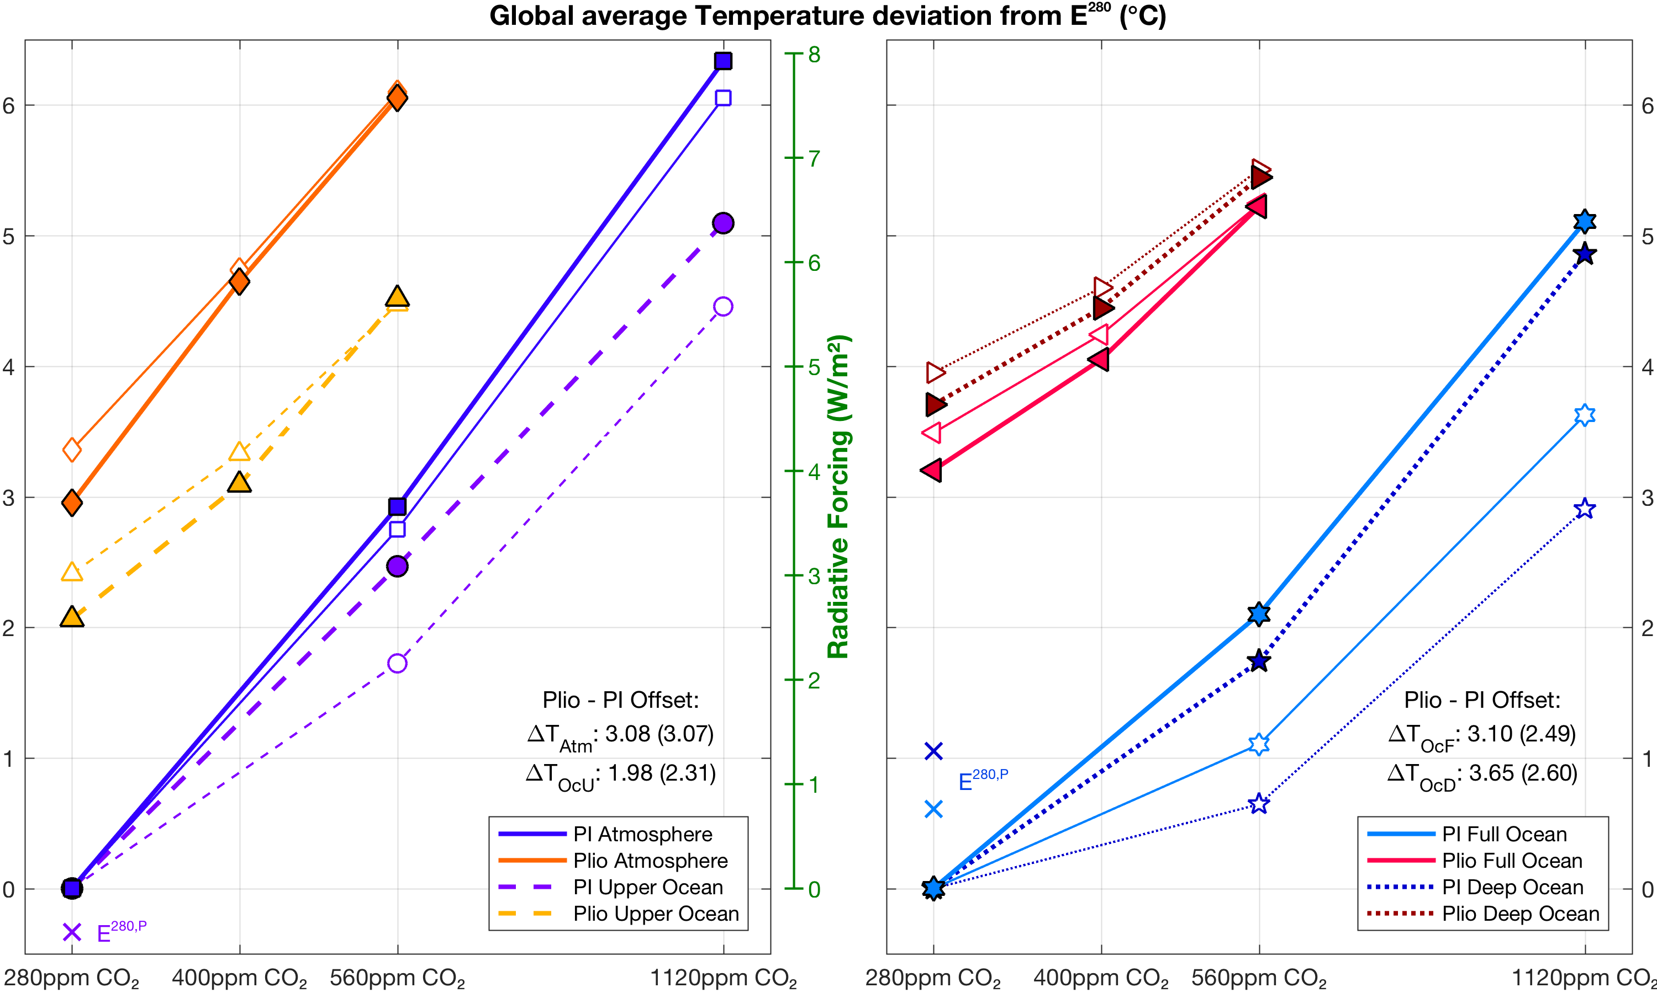
The Pliocene: not just greenhouse gases
Boundary conditions
have a large effect.
Pliocene – pre-industrial similar to CO₂ doubling.

Slide 30
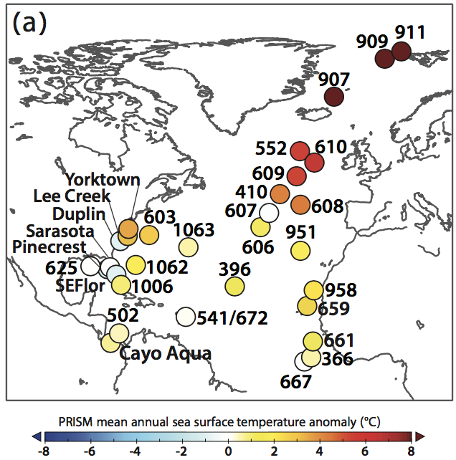
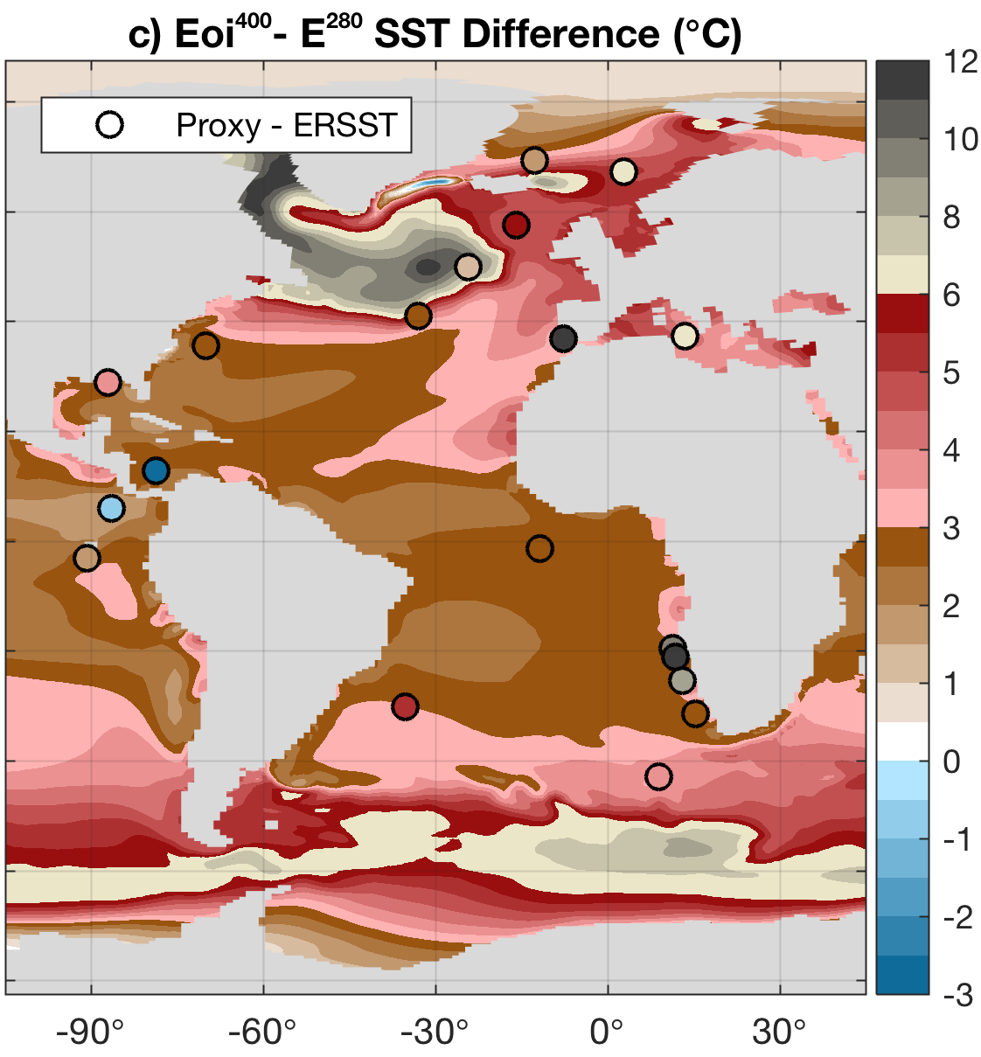
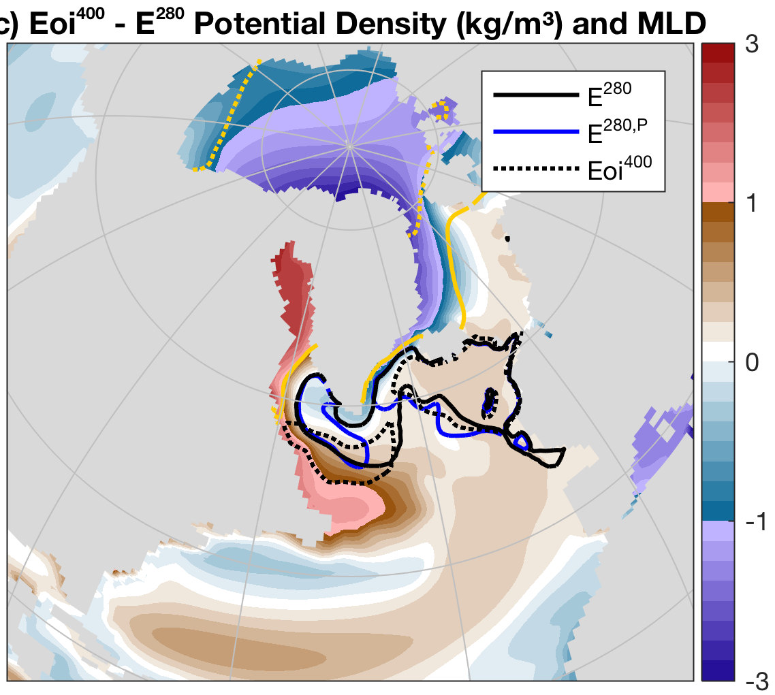
Pliocene: North Atlantic warmth
Strength of the Atlantic Meridional Ovcerturning Cicrulation (AMOC)
is highly sensitive in the models to a closure of Arctic gateways;

Slide 31
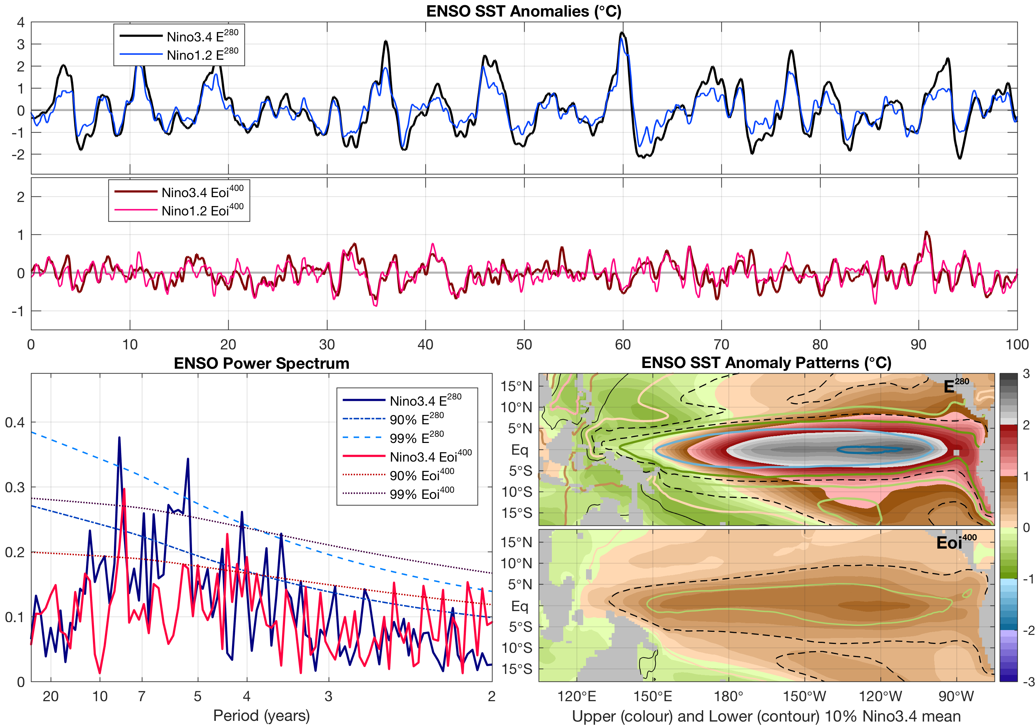
Pliocene: permanent El Niño?
ENSO variability is
much weaker in
Pliocene simulations.
Often suggested that
there was a so-called
permanent El Niño.
Not supported by models; mostly weaker,
but no specific state.

Slide 32
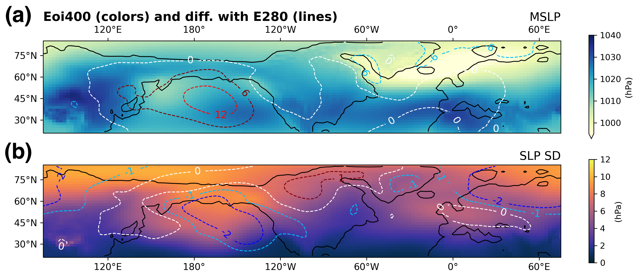
Pliocene as future analogue: what about variability?
Pliocene temperatures comparable to ~2100.
Patterns of sea level pressure change.
Variability patterns
change even more.
The Weather conditions
may be very different!
Oldeman et al. (in review)

Slide 33
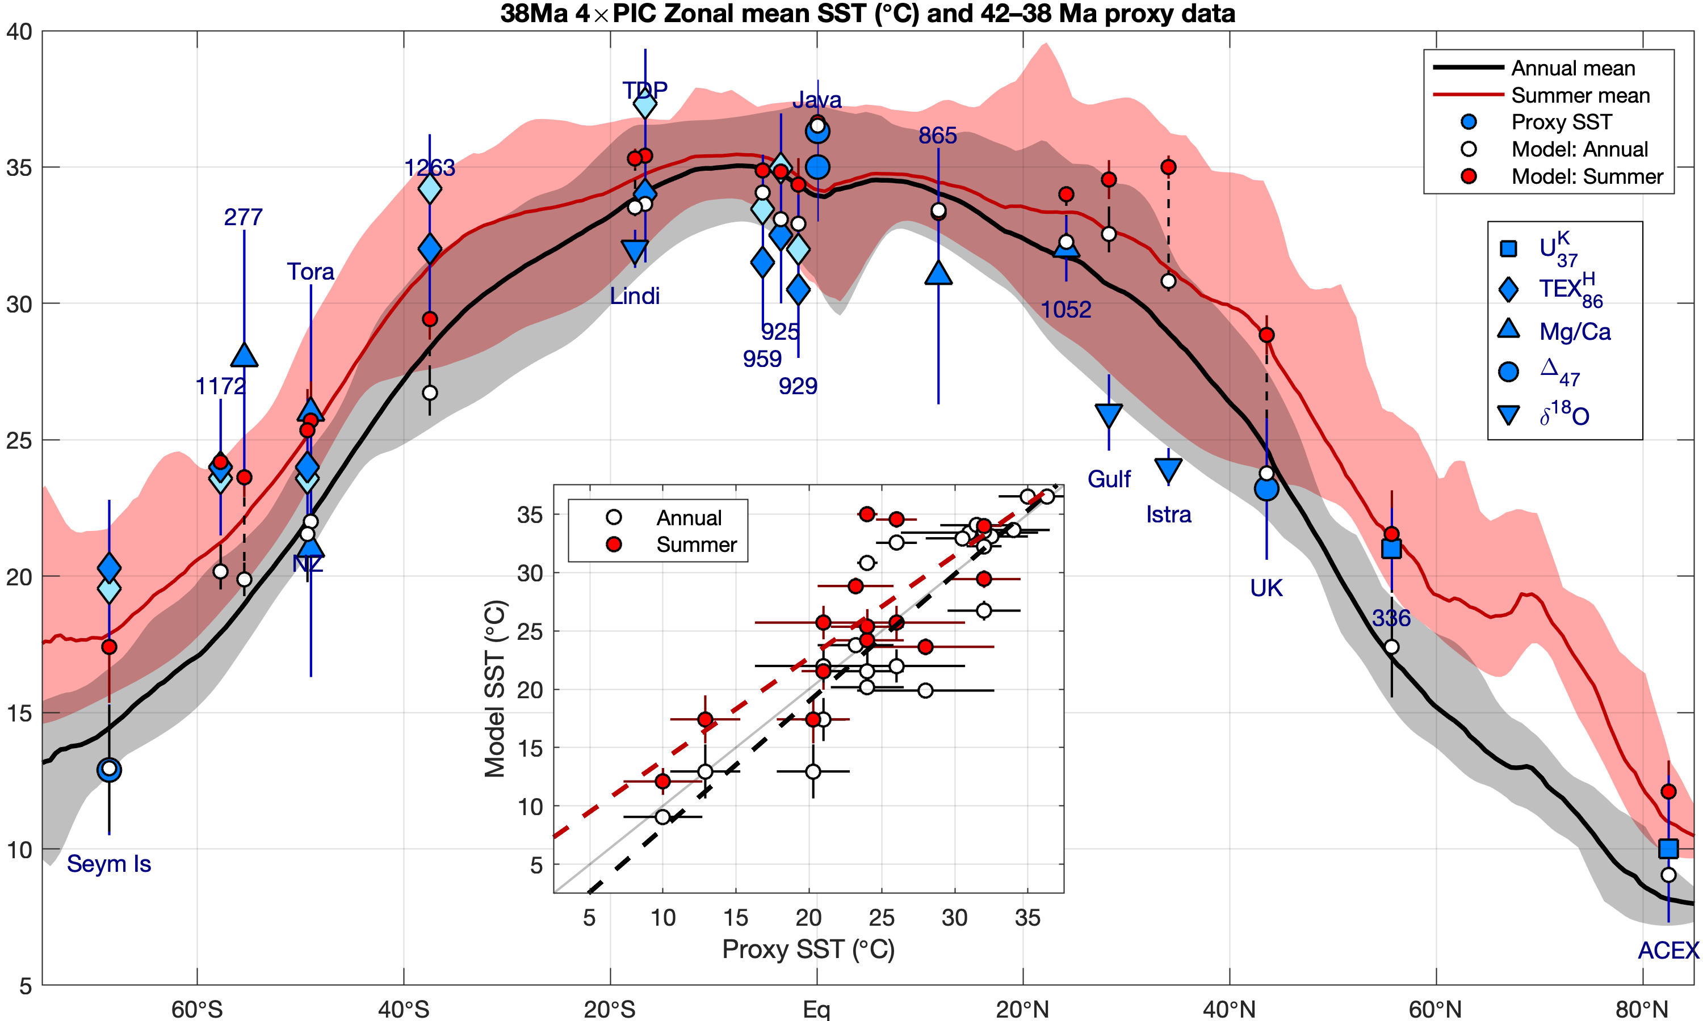
The Eocene hothouse: ocean temperature
Comparison
to SST ‘proxies’.
Gradient captured well in simulation.
If the model does well here, can we trust it
for other studies?

Slide 34
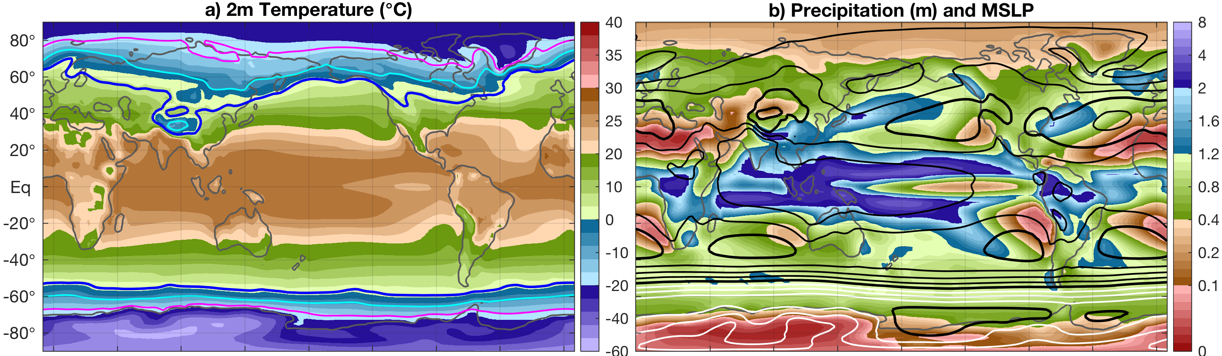
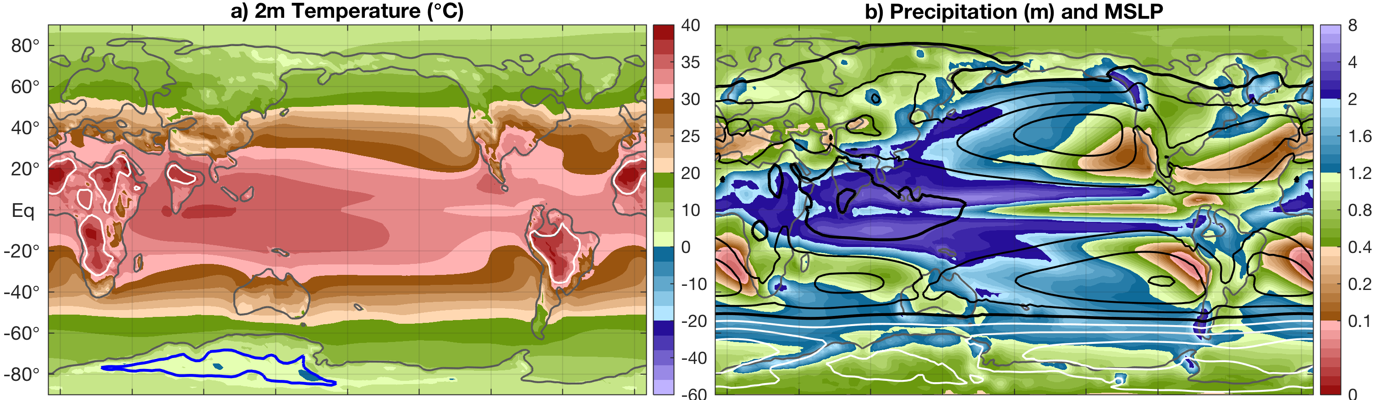
Pre-industrial
38Ma Eocene

Slide 35
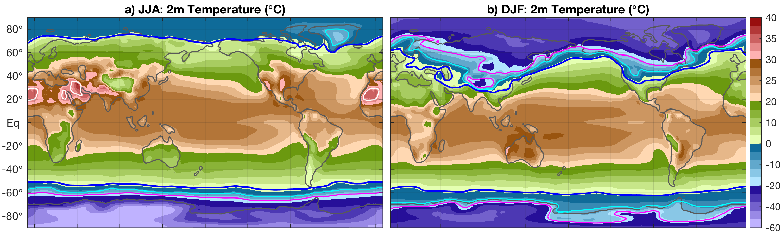
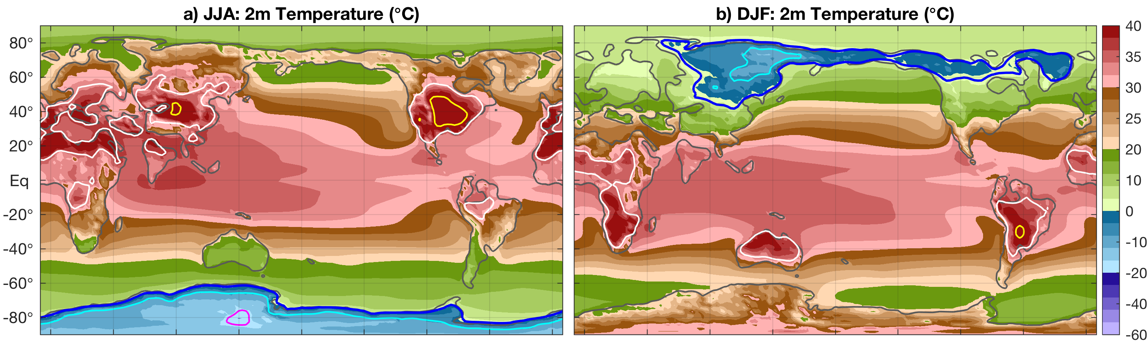
Pre-industrial
38Ma Eocene

Slide 36
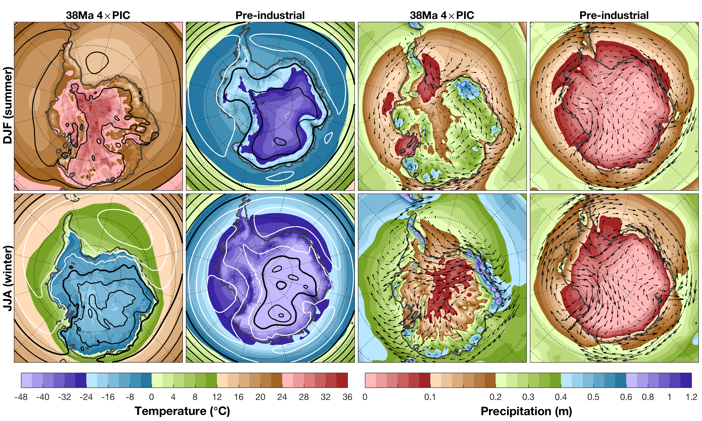
Eocene climate: what happens on Antarctica?
Very warm
in summer,
also highest temperatures near the pole.

Slide 37
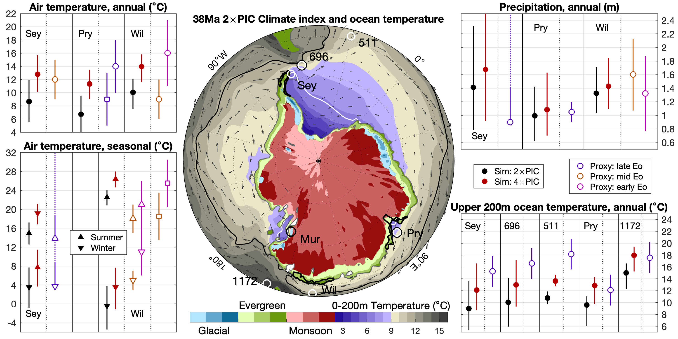
Antarctic monsoons: vegetation and ice?

Slide 38
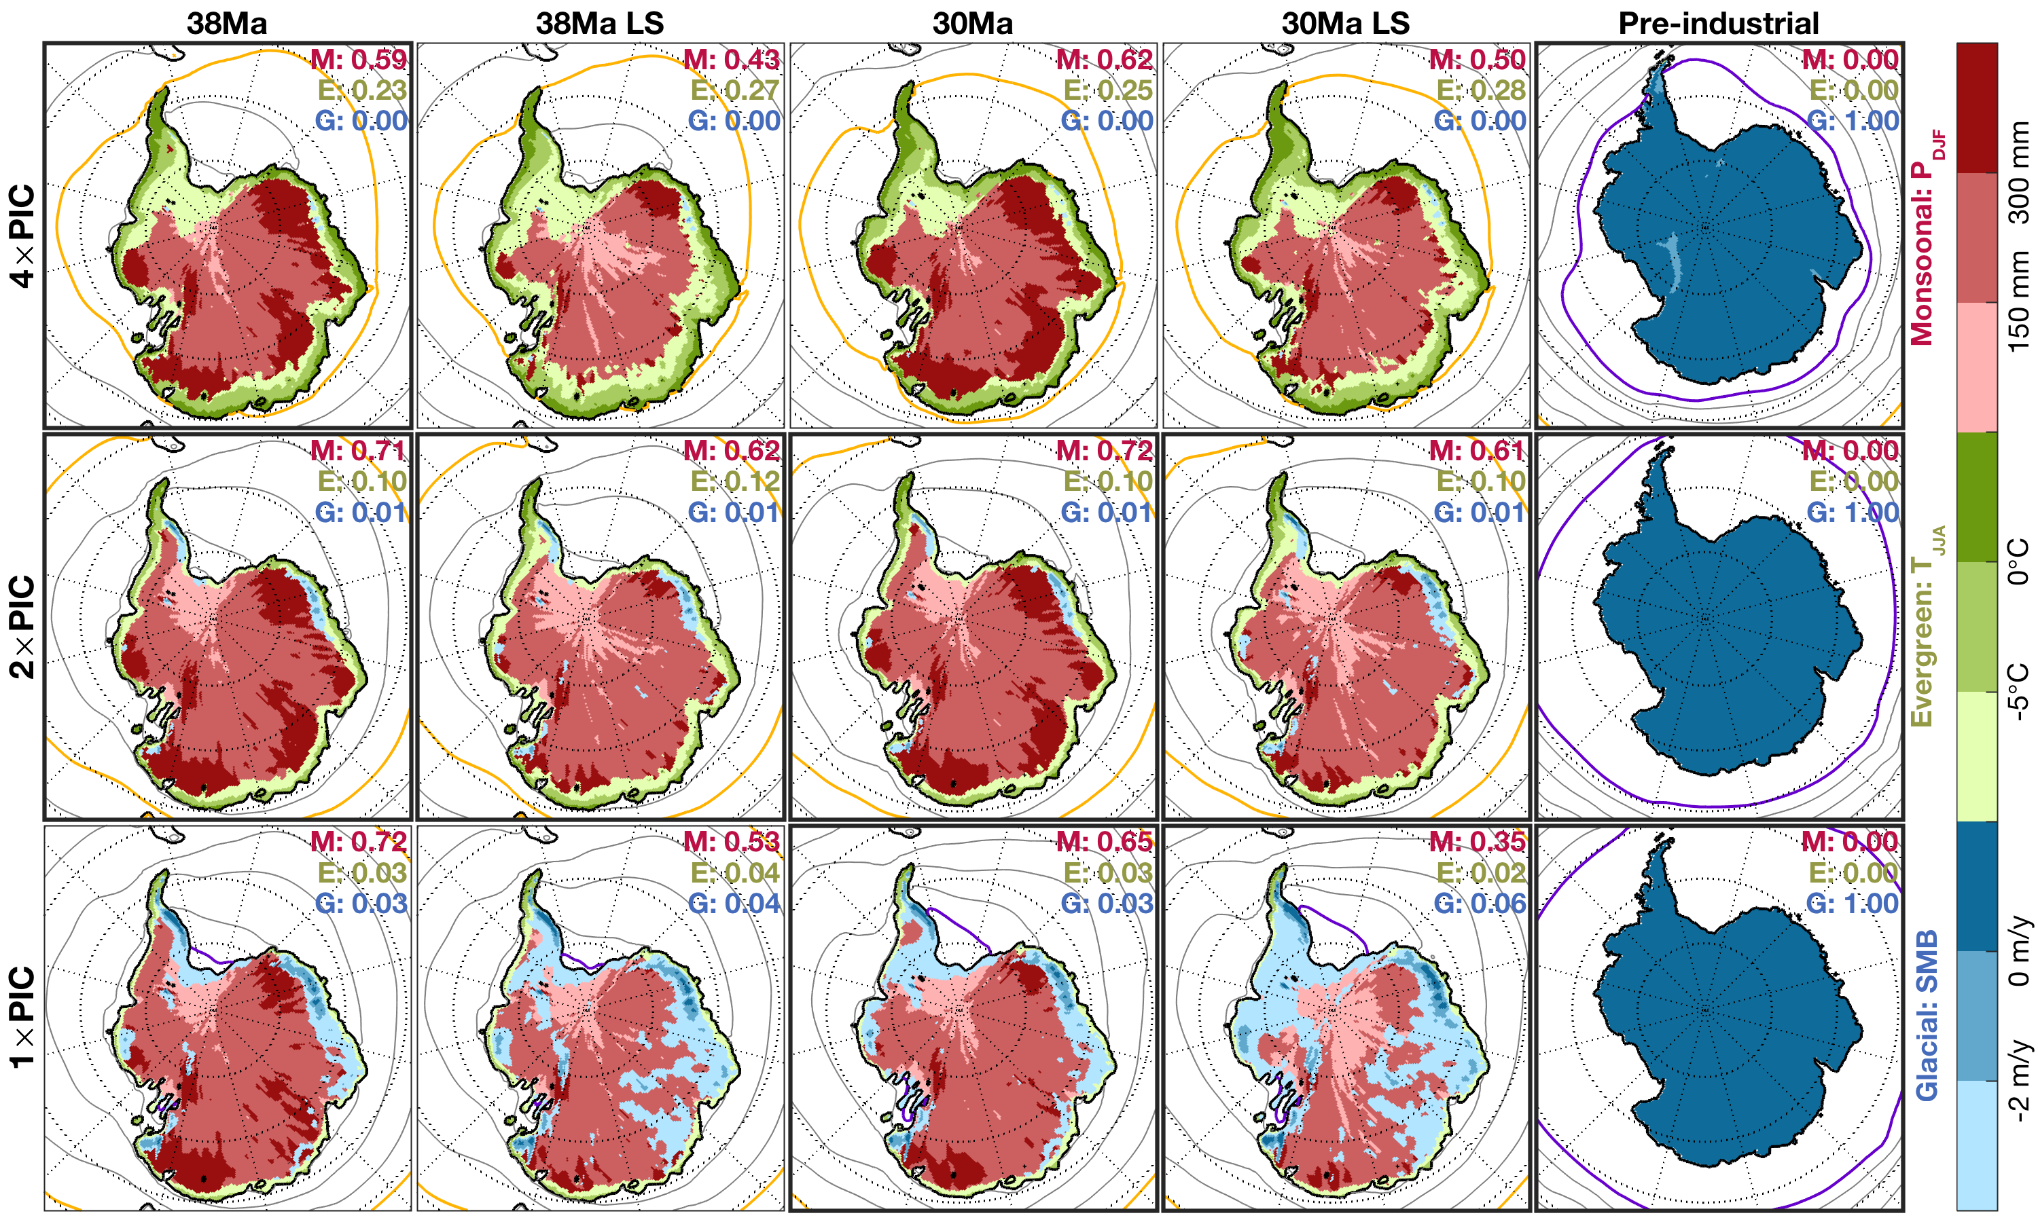
Antarctic monsoonal climate is very resilient

Slide 39
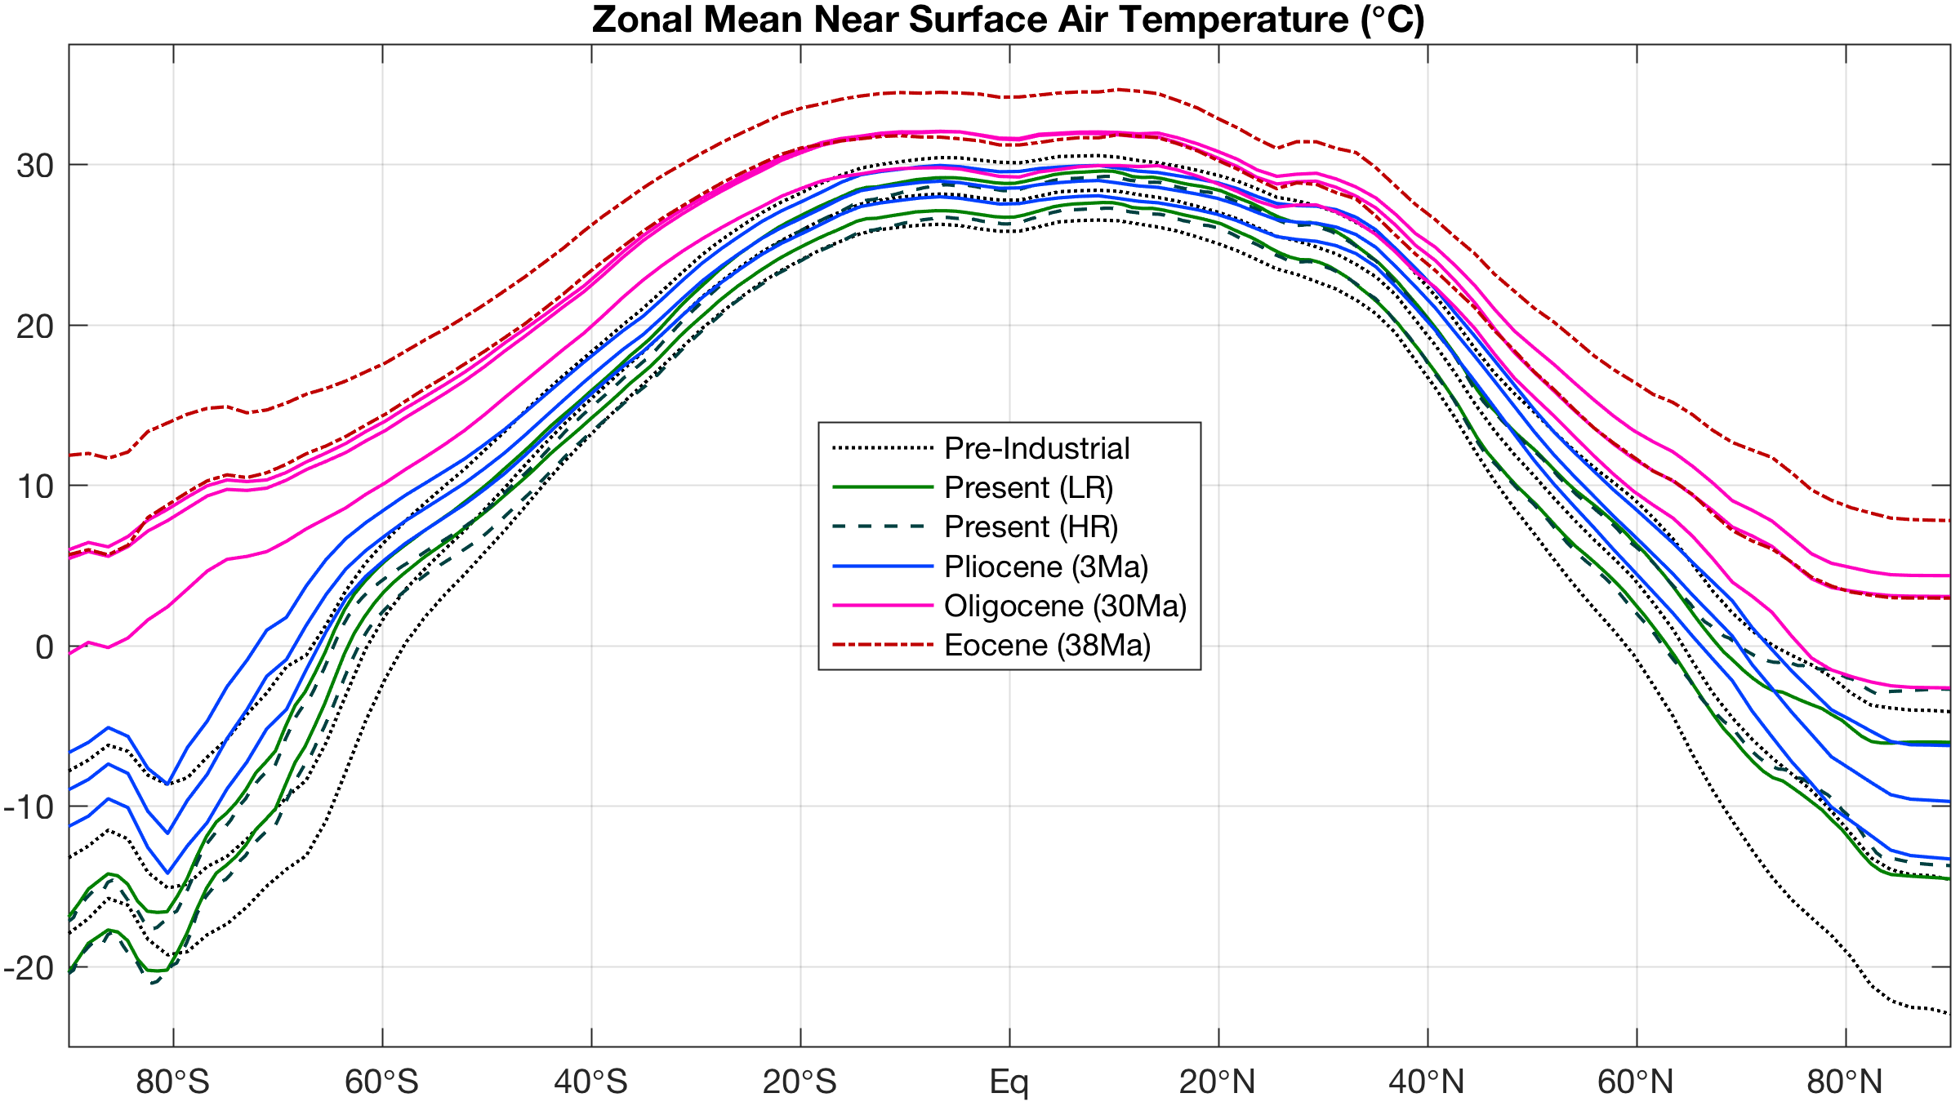
General lessons from past warm climates

Slide 40
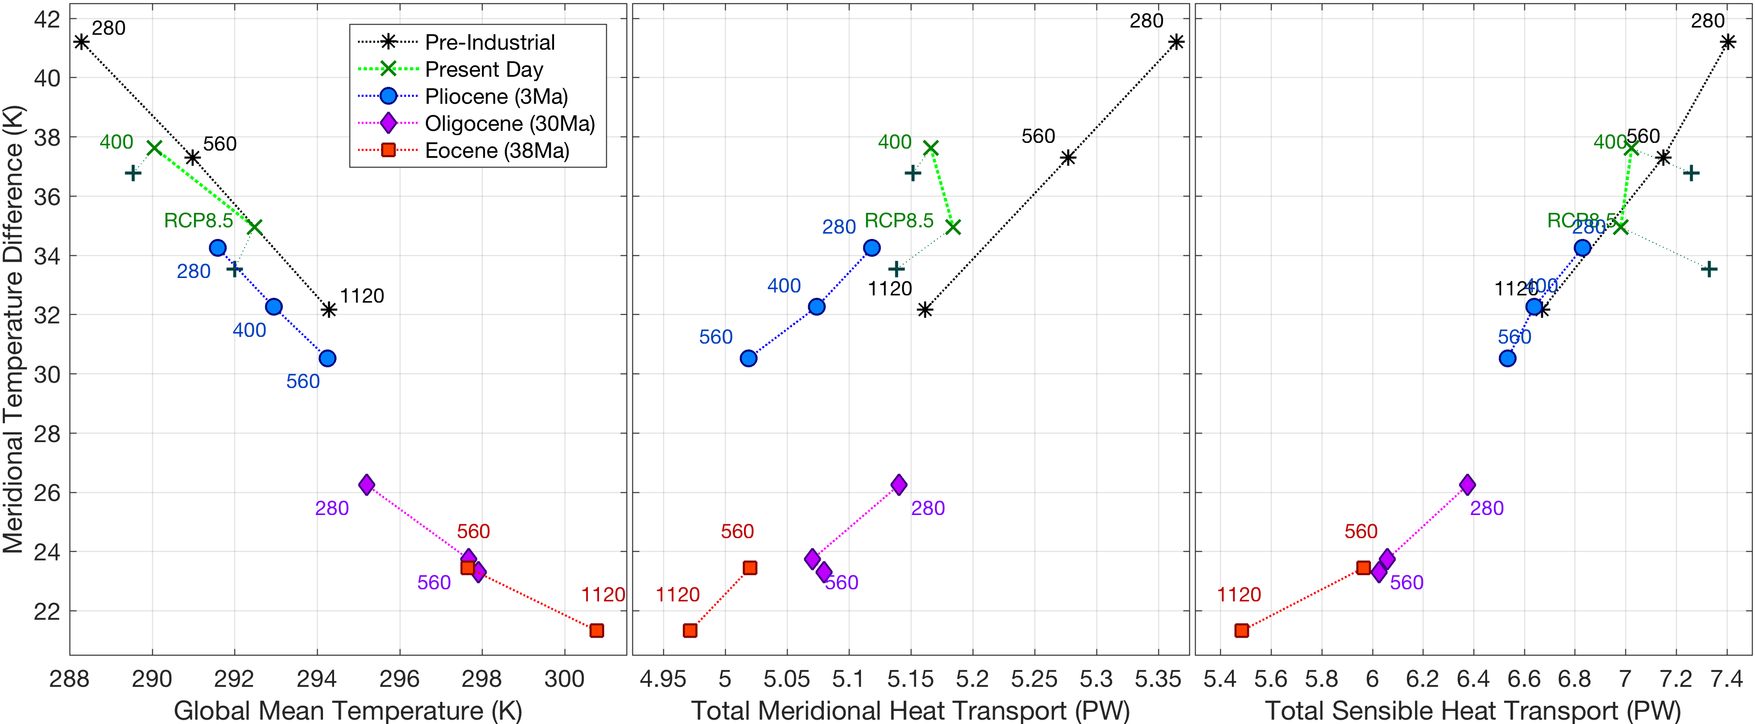
Equable climates: a heat flux paradox?
Warmer → reduced gradient → weaker transport

Slide 41
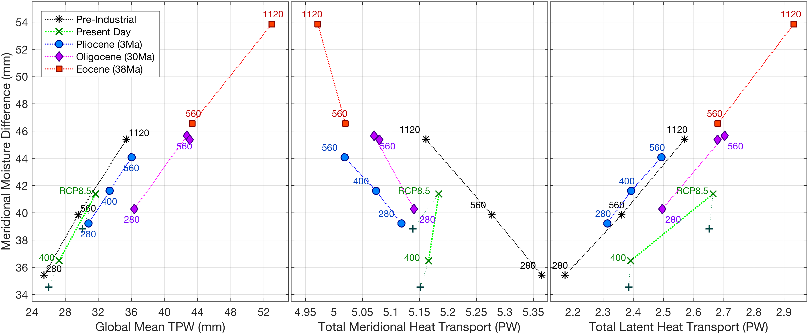
Equable climates: not in terms of moisture!
Warmer → enhanced gradient → stronger transport

Slide 42
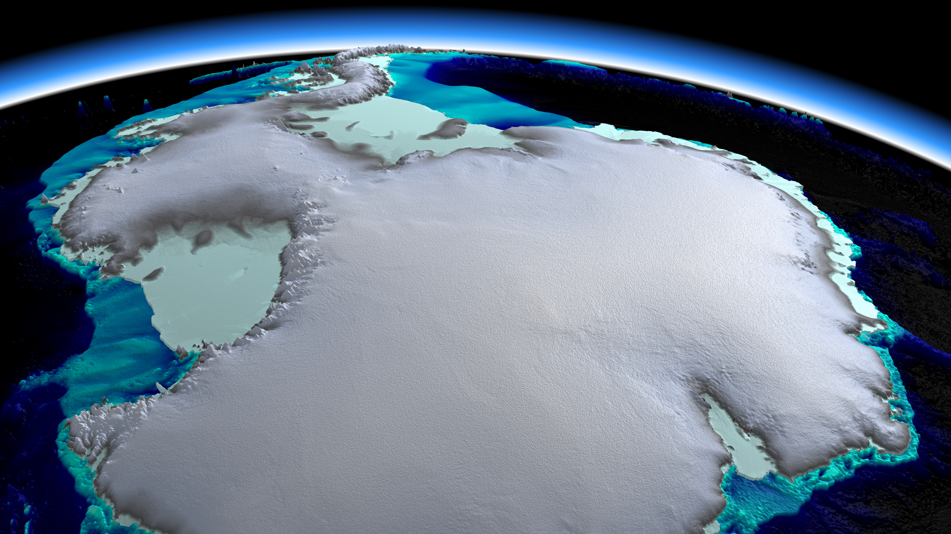
Thank you for listening!
m.l.j.baatsen@uu.nl

